Slide 1
Fine-Tuning Diffusion Models by Direct Preference Optimization
Presenter: Zhanhao Liang
The Australian National University

Slide 2
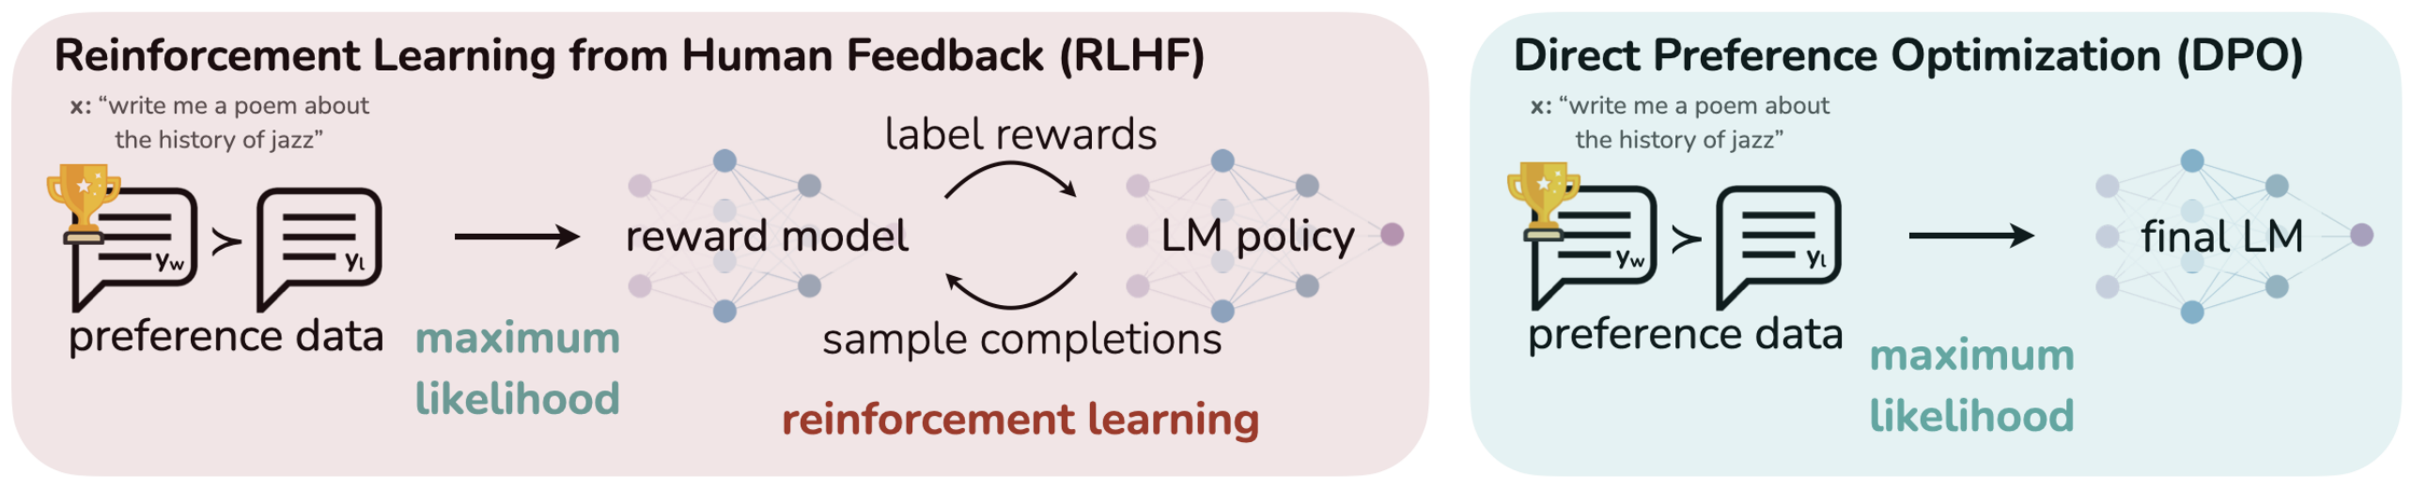
What is Direct Preference Optimization (DPO)
Rafailov, Rafael, et al. "Direct preference optimization: Your language model is secretly a reward model." Advances in neural information processing systems 36 (2023): 53728-53741.

Slide 3
What is Direct Preference Optimization (DPO)
Rafailov, Rafael, et al. "Direct preference optimization: Your language model is secretly a reward model." Advances in neural information processing systems 36 (2023): 53728-53741.

Slide 4
Can we employ the idea of DPO in the alignment of diffusion models?

Slide 5

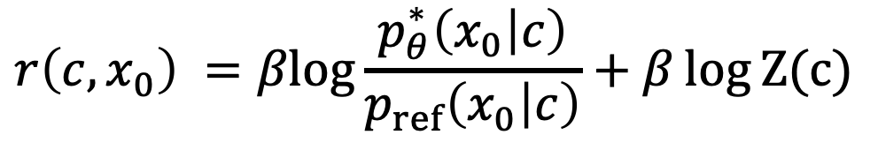
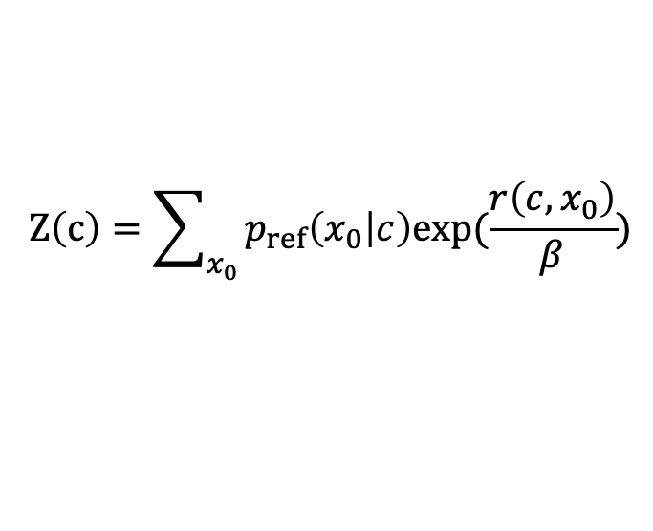
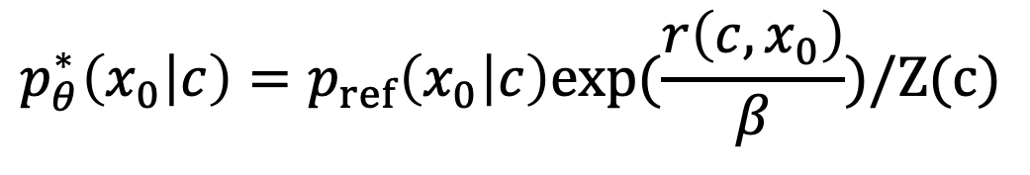
DPO Objective for Diffusion Models
$$\max_{p_{θ}}{𝔼_{c\sim D_{c}, x_{0}\sim p_{θ}(x_{0}|c)}\left[r\left(c,x_{0}\right)\right]− β𝔻_{KL}[p_{θ}(x_{0}|c)∥p_{ref}(x_{0}|c)]}$$
Unique global optimal solution:
$$p_{θ}^{∗}\left(x_{0} | c\right)=p_{ref}\left(x_{0} | c\right)exp(\frac{r\left(c,x_{0}\right)}{β})/Z(c)$$
$$Z\left(c\right)=\sum_{x_{0}}{p_{ref}\left(x_{0} | c\right)exp(\frac{r\left(c,x_{0}\right)}{β})}$$
$$⇕$$
$$r\left(c,x_{0}\right) =βlog\frac{p_{θ}^{∗}\left(x_{0} | c\right)}{p_{ref}\left(x_{0} | c\right)}+β\log{Z(c)}$$

Slide 6
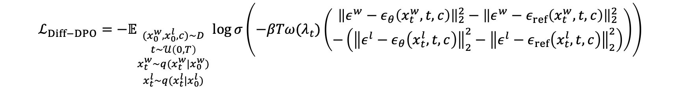
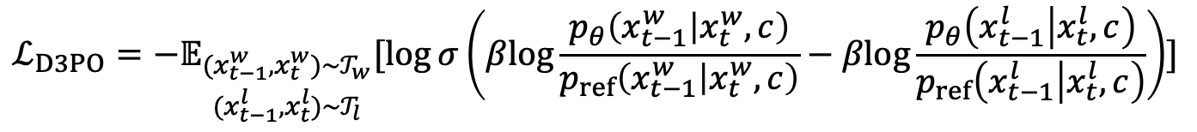
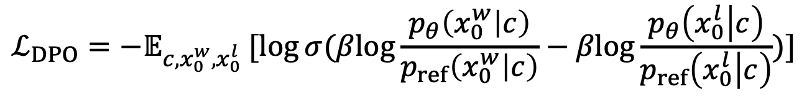
DPO Objective for Diffusion Models
$$ℒ_{reward}=−𝔼_{c,x_{0}^{w},x_{0}^{l} }[\log{σ(r_{φ}\left(c,x_{0}^{w}\right)−r_{φ}\left(c,x_{0}^{l}\right))}]$$
$$ℒ_{DPO}=−𝔼_{c,x_{0}^{w},x_{0}^{l} }[\log{σ(βlog\frac{p_{θ}\left(x_{0}^{w} | c\right)}{p_{ref}\left(x_{0}^{w} | c\right)}−βlog\frac{p_{θ}\left(x_{0}^{l} | c\right)}{p_{ref}\left(x_{0}^{l} | c\right)})}]$$
For Diffusion:
$$ℒ_{Diff−DPO}=−𝔼_{\begin{aligned}{(x}_{0}^{w},x_{0}^{l},c)\sim D \\ \begin{aligned}t\sim 𝒰\left(0,T\right) \\ x_{t}^{w}\sim q(x_{t}^{w}|x_{0}^{w}) \\ x_{t}^{l}\sim q(x_{t}^{l}|x_{0}^{l})\end{aligned}\end{aligned}}\log{σ}\left(−βTω(λ_{t})\left(\begin{aligned}{\left\|ε^{w}−ε_{θ}\left(x_{t}^{w},t,c\right)\right\|}_{2}^{2}−{\left\|ε^{w}−ε_{ref}\left(x_{t}^{w},t,c\right)\right\|}_{2}^{2} \\ −\left({\left\|ε^{l}−ε_{θ}\left(x_{t}^{l},t,c\right)\right\|}_{2}^{2}−{\left\|ε^{l}−ε_{ref}\left(x_{t}^{l},t,c\right)\right\|}_{2}^{2}\right)\end{aligned}\right)\right)$$
Diffusion-DPO:
$$ℒ_{D3PO}=−𝔼_{\begin{aligned}{(x}_{t−1}^{w},x_{t}^{w})\sim 𝒯_{w} \\ {(x}_{t−1}^{l},x_{t}^{l})\sim 𝒯_{l}\end{aligned}}[\log{σ\left(βlog\frac{p_{θ}\left(x_{t−1}^{w} | x_{t}^{w},c\right)}{p_{ref}\left(x_{t−1}^{w} | x_{t}^{w},c\right)}−βlog\frac{p_{θ}\left(x_{t−1}^{l} | x_{t}^{l},c\right)}{p_{ref}\left(x_{t−1}^{l} | x_{t}^{l},c\right)}\right)}]$$
D3PO:

Slide 7

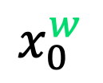

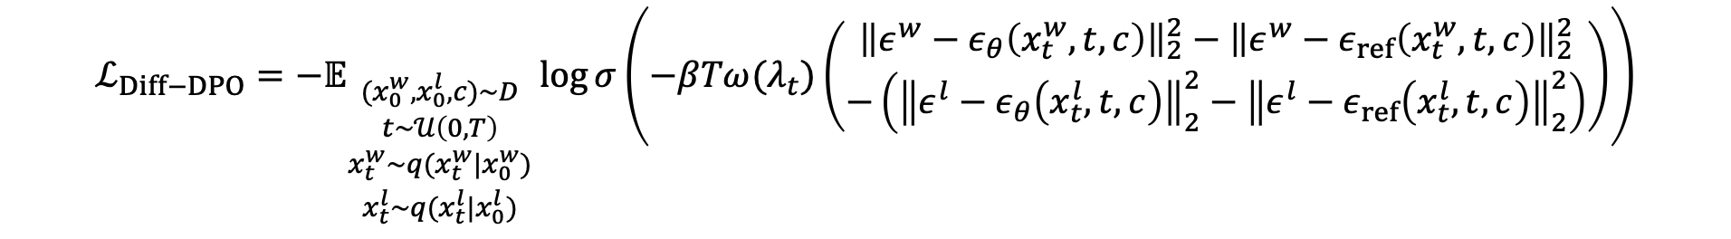


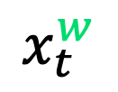



Diffusion-DPO
$$x_{t}^{w}$$
$$+ ε$$
$$x_{0}^{w}$$
$$ε_{θ}\left(x_{t}^{w},t,c\right)$$
$$ℒ_{Diff−DPO}$$
$$ε_{θ}\left(x_{t}^{l},t,c\right)$$
$$x_{t}^{l}$$
$$x_{0}^{l}$$
$$+ ε$$
$$ℒ_{Diff−DPO}=−𝔼_{\begin{aligned}{(x}_{0}^{w},x_{0}^{l},c)\sim D \\ \begin{aligned}t\sim 𝒰\left(0,T\right) \\ x_{t}^{w}\sim q(x_{t}^{w}|x_{0}^{w}) \\ x_{t}^{l}\sim q(x_{t}^{l}|x_{0}^{l})\end{aligned}\end{aligned}}\log{σ}\left(−βTω(λ_{t})\left(\begin{aligned}{\left\|ε^{w}−ε_{θ}\left(x_{t}^{w},t,c\right)\right\|}_{2}^{2}−{\left\|ε^{w}−ε_{ref}\left(x_{t}^{w},t,c\right)\right\|}_{2}^{2} \\ −\left({\left\|ε^{l}−ε_{θ}\left(x_{t}^{l},t,c\right)\right\|}_{2}^{2}−{\left\|ε^{l}−ε_{ref}\left(x_{t}^{l},t,c\right)\right\|}_{2}^{2}\right)\end{aligned}\right)\right)$$
Wallace, Bram, et al. "Diffusion model alignment using direct preference optimization." 2024 IEEE/CVF Conference on Computer Vision and Pattern Recognition (CVPR). IEEE, 2024.

Slide 8
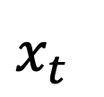

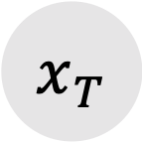
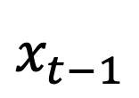

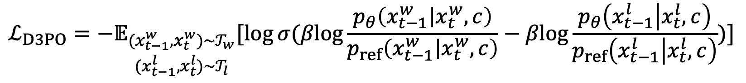


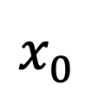


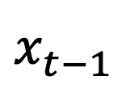
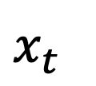

D3PO
$$w$$
$$w$$
· · ·
$$x_{t}^{}$$
$$x_{t−1}^{}$$
· · ·
$$w$$
$$x_{0}^{}$$
$$x_{T}$$
Preference
Evaluator
$$l$$
$$l$$
$$x_{0}^{}$$
$$l$$
· · ·
$$x_{t}^{}$$
$$x_{t−1}^{}$$
· · ·
$$ℒ_{D3PO}=−𝔼_{\begin{aligned}{(x}_{t−1}^{w},x_{t}^{w})\sim 𝒯_{w} \\ {(x}_{t−1}^{l},x_{t}^{l})\sim 𝒯_{l}\end{aligned}}[\log{σ(βlog\frac{p_{θ}\left(x_{t−1}^{w} | x_{t}^{w},c\right)}{p_{ref}\left(x_{t−1}^{w} | x_{t}^{w},c\right)}−βlog\frac{p_{θ}\left(x_{t−1}^{l} | x_{t}^{l},c\right)}{p_{ref}\left(x_{t−1}^{l} | x_{t}^{l},c\right)})}]$$
Yang, Kai, et al. "Using human feedback to fine-tune diffusion models without any reward model." 2024 IEEE/CVF Conference on Computer Vision and Pattern Recognition (CVPR). IEEE, 2024.

Slide 9
Roadmap
Step-Level Preference Is Unknown
Latents are Off-Trajectory
Is the reference the right anchor?
How should pairs be weighted?
How to Handle CFG
Does the Diffusion-DPO loss really do its job?

Slide 10
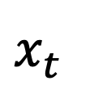

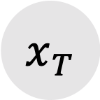
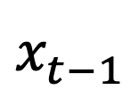





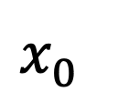


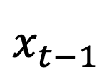
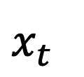
Challenge 1: Step-Level Preference Is Unknown
$$w$$
$$w$$
· · ·
$$x_{t}^{}$$
$$x_{t−1}^{}$$
· · ·
$$w$$
$$x_{0}^{}$$
$$x_{T}$$
$$≻$$
$x_{0}^{w}≻x_{0}^{l}$/ $𝒯_{w}≻𝒯_{l}$
$$l$$
$$l$$
$$x_{0}^{}$$
$$l$$
· · ·
$$x_{t}^{}$$
$$x_{t−1}^{}$$
· · ·
$$x_{t}^{w}≻x_{t}^{l }?$$
$$x_{t−1}^{w}≻x_{t−1}^{l }?$$

Slide 11
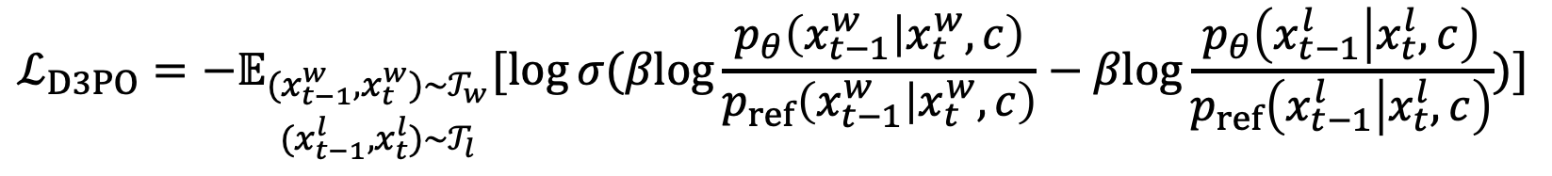

For D3PO:
$$x_{t−1}^{w}≻x_{t−1}^{l }, t∈[1, T]$$
It assumes:
$$ℒ_{D3PO}=−𝔼_{\begin{aligned}{(x}_{t−1}^{w},x_{t}^{w})\sim 𝒯_{w} \\ {(x}_{t−1}^{l},x_{t}^{l})\sim 𝒯_{l}\end{aligned}}[\log{σ(βlog\frac{p_{θ}\left(x_{t−1}^{w} | x_{t}^{w},c\right)}{p_{ref}\left(x_{t−1}^{w} | x_{t}^{w},c\right)}−βlog\frac{p_{θ}\left(x_{t−1}^{l} | x_{t}^{l},c\right)}{p_{ref}\left(x_{t−1}^{l} | x_{t}^{l},c\right)})}]$$

Slide 12
1. Implicit: distribute the trajectory label over steps

Slide 13
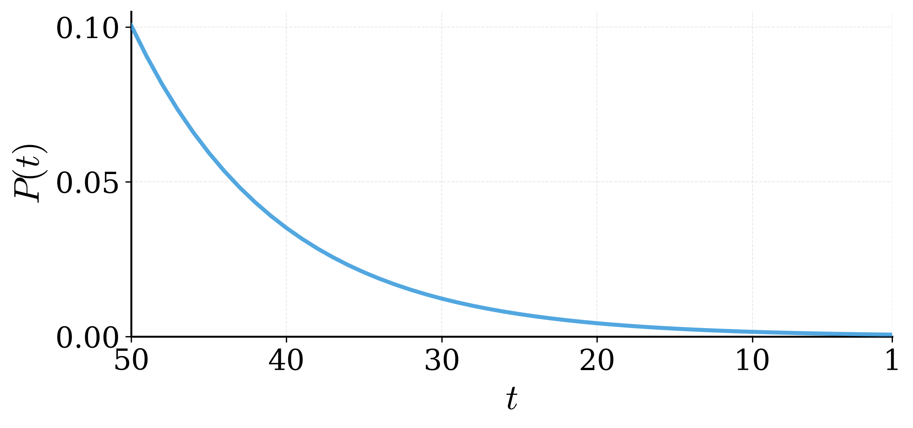
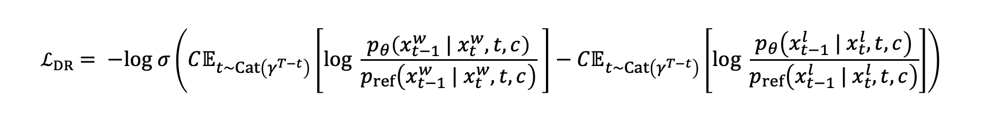



DenseReward
Assumes a dense per-step reward whose discounted sum determines the trajectory preference
$$ℒ_{DR}= −log σ\left(C𝔼_{t∼Cat\left(γ^{T−t}\right)}\left[log \frac{p_{θ}\left(x_{t−1}^{w} | x_{t}^{w},t,c\right)}{p_{ref}\left(x_{t−1}^{w} | x_{t}^{w},t,c\right)} \right]−C𝔼_{t∼Cat\left(γ^{T−t}\right)}\left[log \frac{p_{θ}\left(x_{t−1}^{l} | x_{t}^{l},t,c\right)}{p_{ref}\left(x_{t−1}^{l} | x_{t}^{l},t,c\right)}\right]\right)$$
$$t∼Cat\left(γ^{T−t}\right)⇔P\left(t\right)=\frac{γ^{T−t}}{\sum_{j=1}^{T}{γ^{T−j}}}$$
noise side ($x_{T}$)
image side ($x_{0}$)
Yang, Shentao, Tianqi Chen, and Mingyuan Zhou. "A dense reward view on aligning text-to-image diffusion with preference." ICML 2024, PMLR 235: 55998–56032.

Slide 14
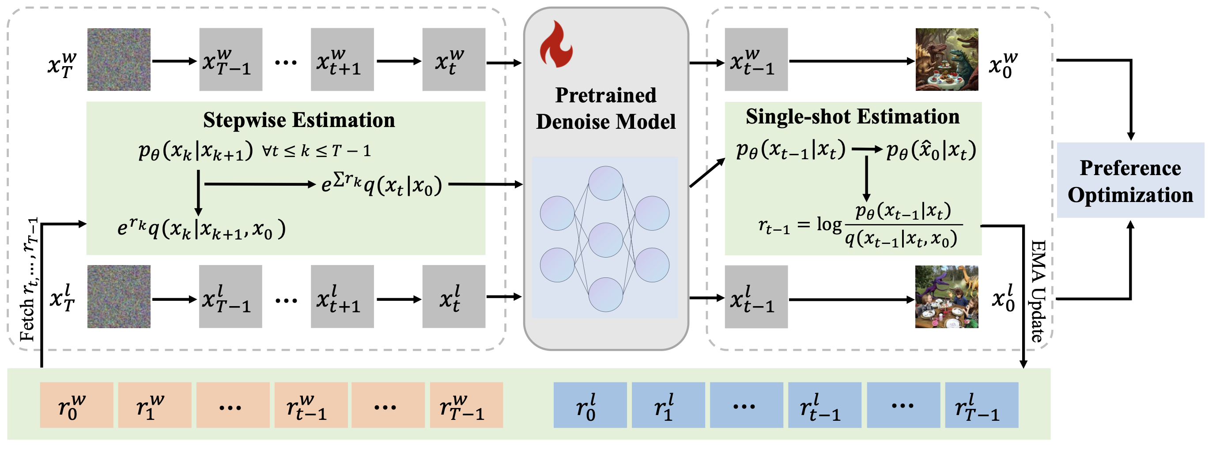
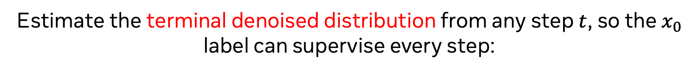

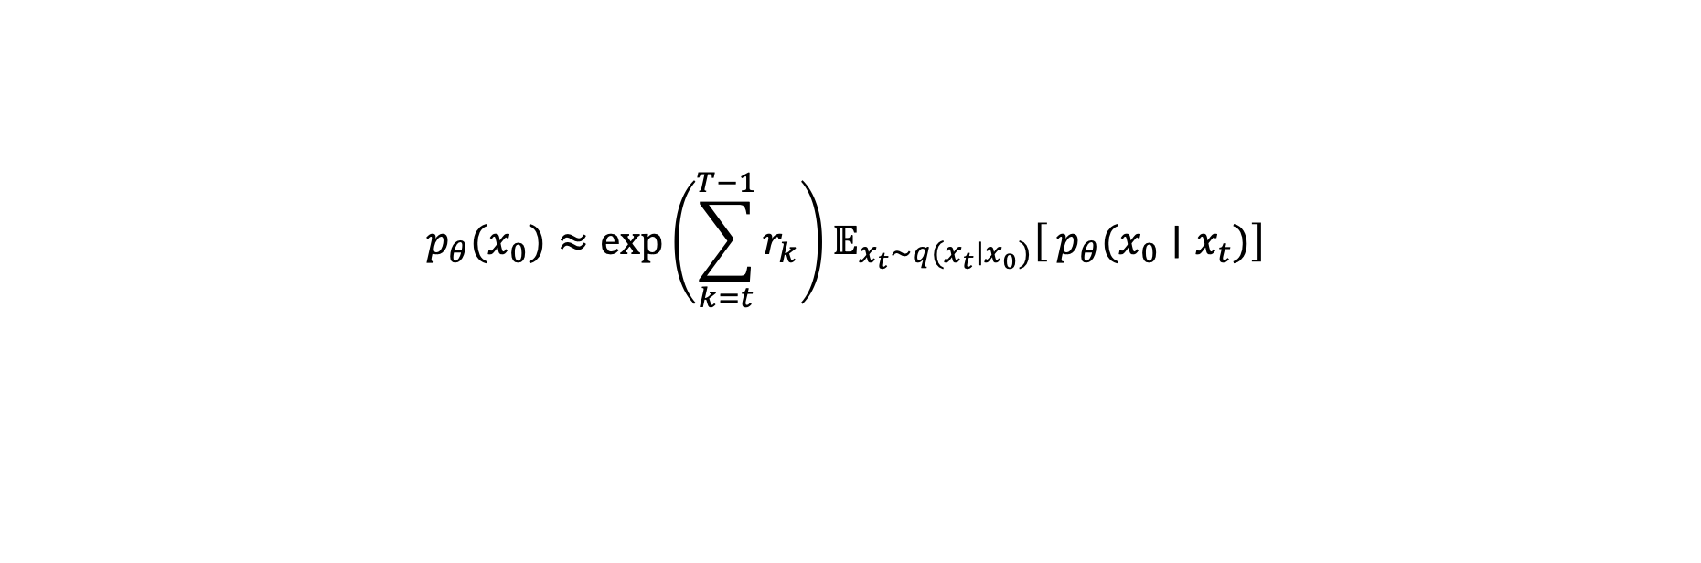
DDE
Estimate the terminal denoised distribution from any step $t$, so the $x_{0}$ label can supervise every step:
$$p_{θ}(x_{0})≈\text{exp}\left(\sum_{k=t}^{T−1}{r_{k}}\right)𝔼_{x_{t}∼q(x_{t}∣x_{0})}\left[ p_{θ}(x_{0}∣x_{t})\right]$$
$$p_{θ}(x_{0}∣x_{t})≈𝒩\left(x_{0}; {\hat{μ}}_{θ}(x_{t},t), σ_{t}I\right)$$
(one DDIM step from $x_{t}$ to $x_{0}$)
Correction Term
Shi, Dingyuan, et al. "Preference alignment for diffusion model via explicit denoised distribution estimation." arXiv preprint arXiv:2411.14871 (2024).

Slide 15
2. Explicit: judge the steps directly

Slide 16
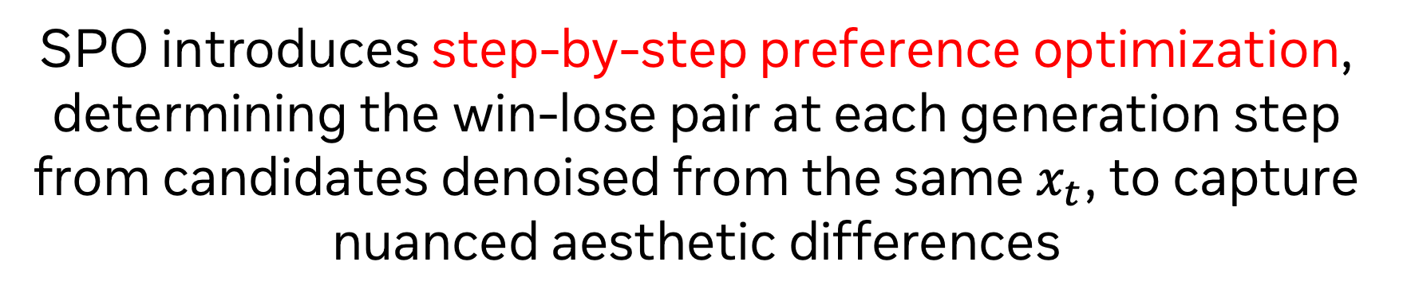
SPO
SPO introduces step-by-step preference optimization, determining the win-lose pair at each generation step from candidates denoised from the same$x_{t}$, to capture nuanced aesthetic differences
Liang, Zhanhao, et al. "Aesthetic post-training diffusion models from generic preferences with step-by-step preference optimization." 2025 IEEE/CVF Conference on Computer Vision and Pattern Recognition (CVPR). IEEE, 2025.

Slide 17
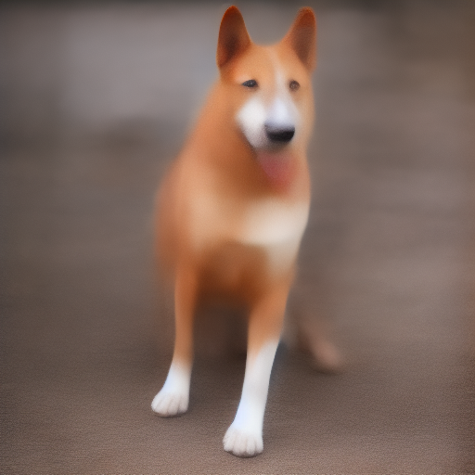
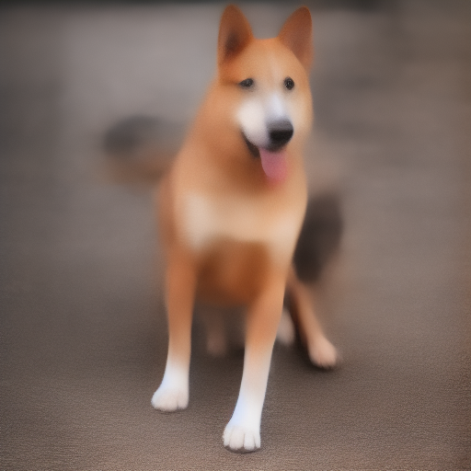
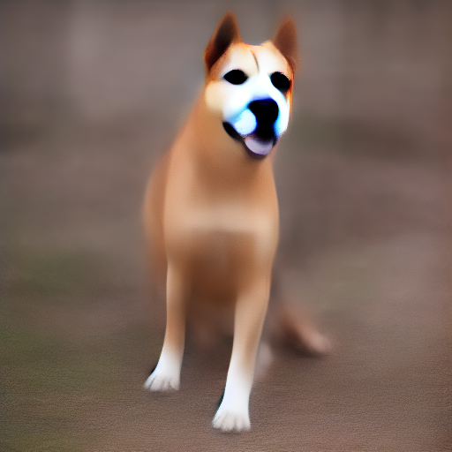
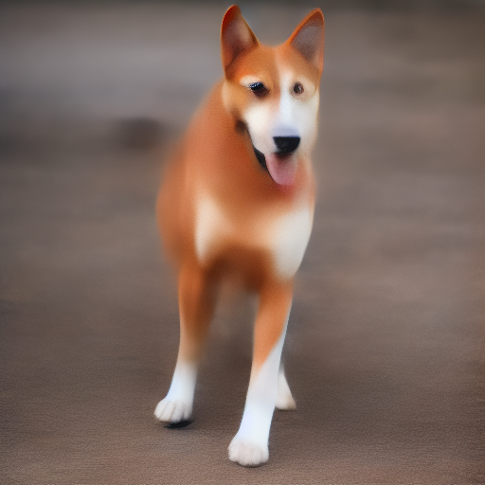
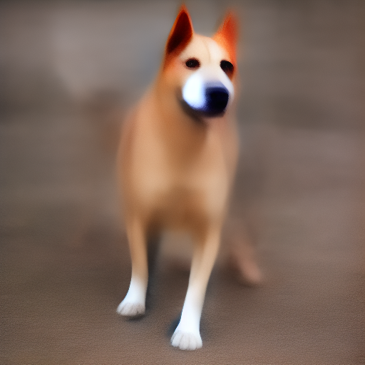
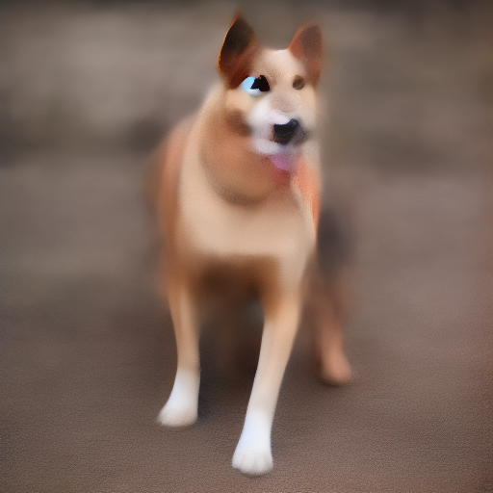
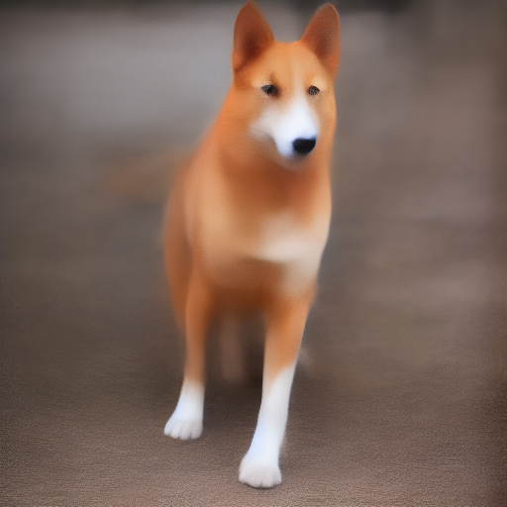
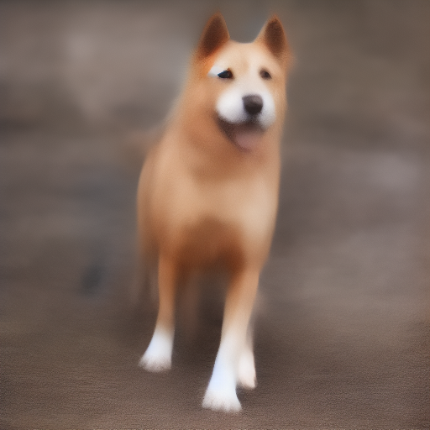
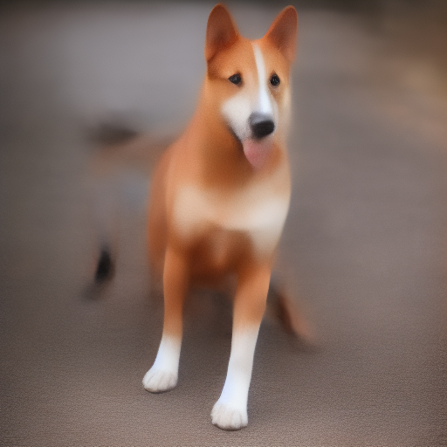
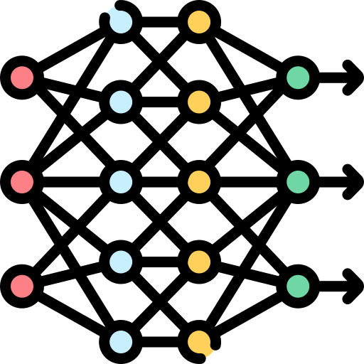

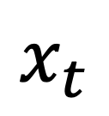
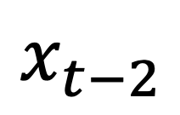
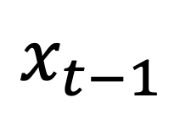
SPO
Prompt:
a beautiful dog
…
$$x_{t}$$
$$x_{t−1}$$
$$x_{t−2}$$

Slide 18



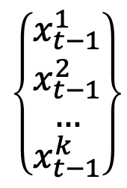

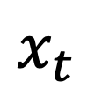
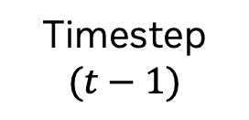
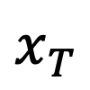

SPO
For t, t-1, t-2, …., 0
$$\left\{\begin{aligned}x_{t−1}^{1} \\ x_{t−1}^{2} \\ … \\ x_{t−1}^{k}\end{aligned}\right\}$$
$$x_{t−1}^{w}$$
$$p_{θ}(x_{t−1}|x_{t})$$
Step-aware Preference Model
$$x_{T}$$
$$x_{t}$$
Random selection
$$x_{t−1}$$
$$x_{0}$$
· · ·
· · ·
$$x_{t−1}^{l}$$
Timestep
$$(t−1)$$
Liang, Zhanhao, et al. "Aesthetic post-training diffusion models from generic preferences with step-by-step preference optimization." 2025 IEEE/CVF Conference on Computer Vision and Pattern Recognition (CVPR). IEEE, 2025.

Slide 19
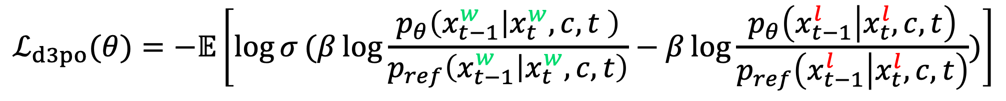
Loss function of SPO:
$$ℒ_{spo}\left(θ\right)=−𝔼\left[\log{σ}(β\log{\frac{p_{θ}\left(x_{t−1}^{w} | x_{t}, c,t\right)}{p_{ref}\left(x_{t−1}^{w} | x_{t}, c,t\right)}}−β\log{\frac{p_{θ}\left(x_{t−1}^{l} | x_{t}, c,t\right)}{p_{ref}\left(x_{t−1}^{l} | x_{t}, c,t\right)}})\right]$$
$$ℒ_{d3po}(θ)=−𝔼\left[\log{σ}(β\log{\frac{p_{θ}\left(x_{t−1}^{w} | x_{t}^{w}, c,t \right)}{p_{ref}\left(x_{t−1}^{w} | x_{t}^{w}, c,t\right)}}−β\log{\frac{p_{θ}\left(x_{t−1}^{l} | x_{t}^{l}, c,t\right)}{p_{ref}\left(x_{t−1}^{l} | x_{t}^{l}, c,t\right)}})\right]$$
Liang, Zhanhao, et al. "Aesthetic post-training diffusion models from generic preferences with step-by-step preference optimization." 2025 IEEE/CVF Conference on Computer Vision and Pattern Recognition (CVPR). IEEE, 2025.

Slide 20
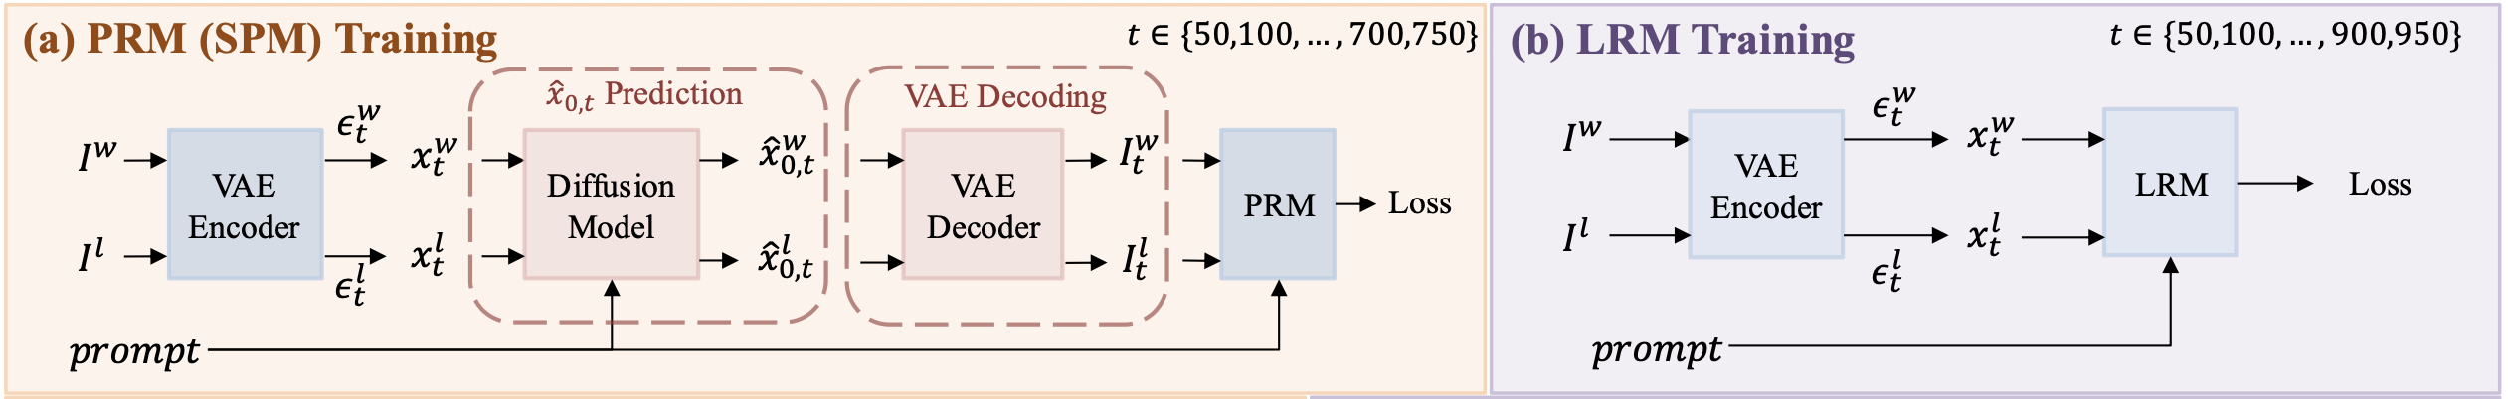
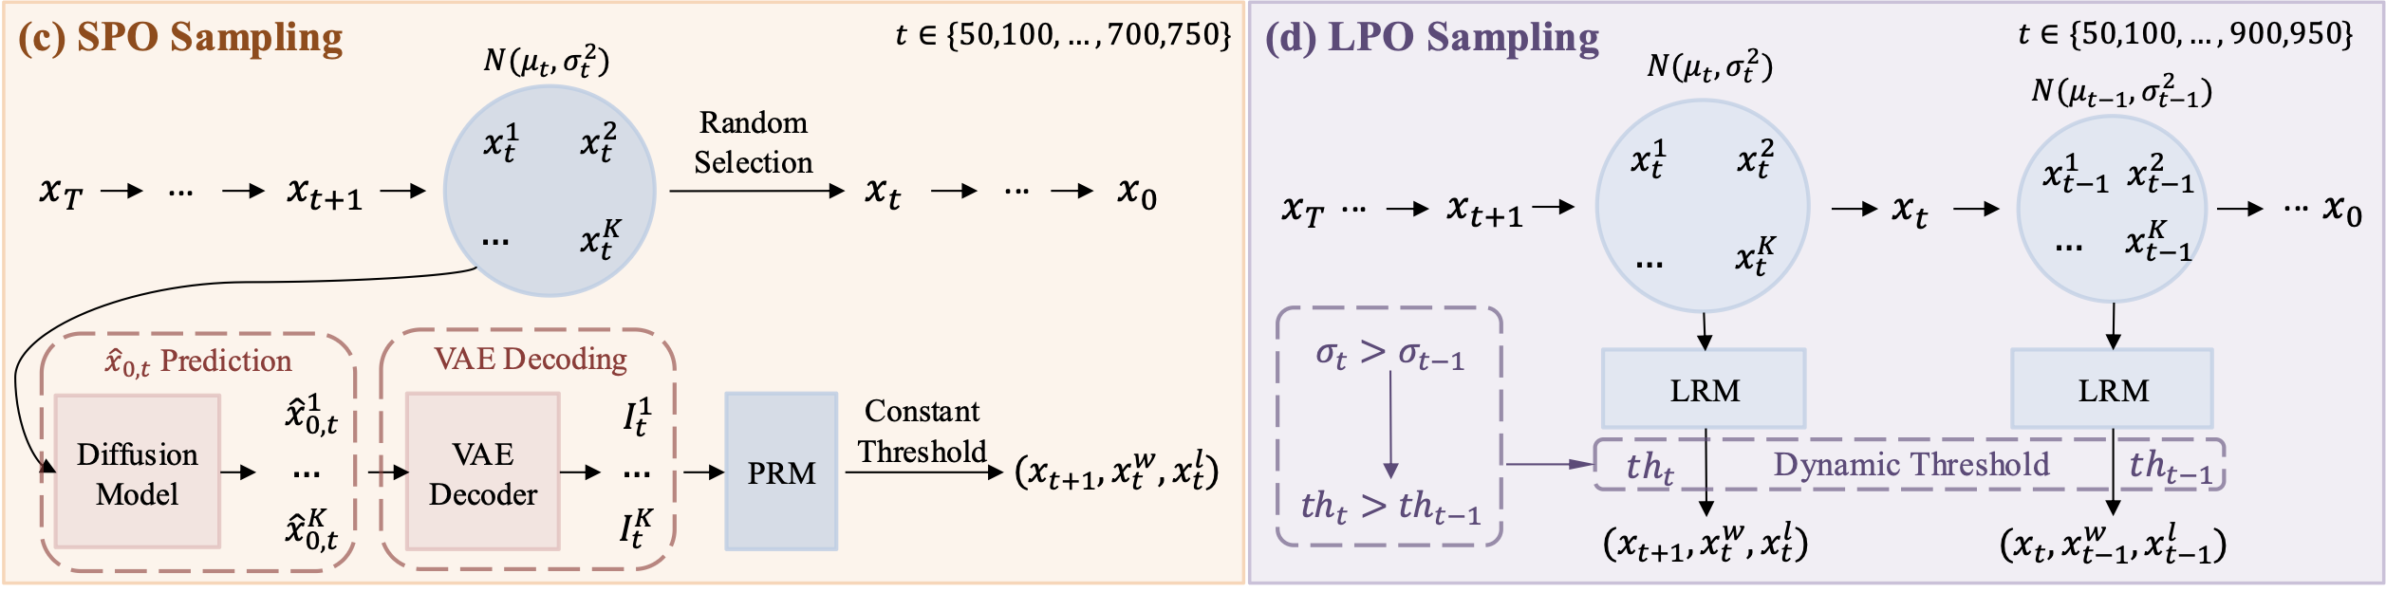
LPO
Step-by-step preference optimization with latent reward model
Zhang, Tao, et al. "Diffusion model as a noise-aware latent reward model for step-level preference optimization." Advances in Neural Information Processing Systems 38 (2026): 106202-106235.

Slide 21

LPO
Build a latent reward model on top of the pre-trained diffusion model:
Zhang, Tao, et al. "Diffusion model as a noise-aware latent reward model for step-level preference optimization." Advances in Neural Information Processing Systems 38 (2026): 106202-106235.

Slide 22

TailorPO-G
Convert a pre-trained clean-image reward model into a step-wise reward:
$$r_{t}\left(c,x_{t}\right)≜𝔼\left[r\left(c,x_{0}\right) | c,x_{t}\right]≈r(c, {\hat{x}}_{0}(x_{t}))$$
Use gradient ascent on the preferred sample to enlarge the reward gap within the pair.
Ren, Jie, et al. "Refining alignment framework for diffusion models with intermediate-step preference ranking." arXiv preprint arXiv:2502.01667 (2025).

Slide 23
















Challenge 2: Latents are Off-Trajectory
$$x_{t}^{w}$$
$$+ ε$$
$$x_{0}^{w}$$
$$ε_{θ}\left(x_{t}^{w},t,c\right)$$
$$ℒ_{Diff−DPO}$$
$$ε_{θ}\left(x_{t}^{l},t,c\right)$$
$$x_{t}^{l}$$
$$x_{0}^{l}$$
$$+ ε$$
$$−ε_{θ}(t)$$
$$−ε_{θ}(t−1)$$
$$−ε_{θ}(1)$$
$$x_{t}$$
$$x_{t−1}^{′}$$
· · ·
$$x_{0}^{′}$$
$$≠$$
$$x_{0}$$
$x_{t}$ is not on any denoising trajectory that $ε_{θ}$ would actually produce!
Wallace, Bram, et al. "Diffusion model alignment using direct preference optimization." 2024 IEEE/CVF Conference on Computer Vision and Pattern Recognition (CVPR). IEEE, 2024.

Slide 24










InPO
Use DDIM inversion to find the $x_{t}$ on the trajectory along which $ε_{θ}$ actually produces $x_{0}$.
DDIM Inversion
$$x_{t}^{w}$$
· · ·
$$x_{κ}^{w}$$
$$x_{0}^{w}$$
$$ε_{gt}^{w}=\frac{x_{t}^{w}−α_{t}x_{0}^{w}}{σ_{t}}$$
$$ε_{θ}\left(x_{t}^{w},t,c\right)$$
$$ℒ_{Diff−DPO}$$
$$ε_{θ}\left(x_{t}^{l},t,c\right)$$
$$ε_{gt}^{l}=\frac{x_{t}^{l}−α_{t}x_{0}^{l}}{σ_{t}}$$
$$x_{t}^{l}$$
· · ·
$$x_{κ}^{l}$$
$$x_{0}^{l}$$
DDIM Inversion
Same loss as Diffusion-DPO, but $x_{t}$ and $ε_{gt}$ come from DDIM inversion
Lu, Yunhong, et al. "InPO: Inversion preference optimization with reparametrized DDIM for efficient diffusion model alignment." 2025 IEEE/CVF Conference on Computer Vision and Pattern Recognition (CVPR). IEEE, 2025.

Slide 25

InPO
Lu, Yunhong, et al. "InPO: Inversion preference optimization with reparametrized DDIM for efficient diffusion model alignment." 2025 IEEE/CVF Conference on Computer Vision and Pattern Recognition (CVPR). IEEE, 2025.

Slide 26

Challenge 3: Is the Reference the Right Anchor?
$$\max_{p_{θ}}{𝔼_{c\sim D_{c}, x_{0}\sim p_{θ}(x_{0}|c)}\left[r\left(c,x_{0}\right)\right]− β𝔻_{KL}[p_{θ}(x_{0}|c)∥p_{ref}(x_{0}|c)]}$$
$$ℒ_{DPO}=−𝔼_{c,x_{0}^{w},x_{0}^{l} }[\log{σ(βlog\frac{p_{θ}\left(x_{0}^{w} | c\right)}{p_{ref}\left(x_{0}^{w} | c\right)}−βlog\frac{p_{θ}\left(x_{0}^{l} | c\right)}{p_{ref}\left(x_{0}^{l} | c\right)})}]$$
KL coefficient
Reference policy: the anchor

Slide 27

SEE-DPO
Introduce a self-entropy regularization mechanism to mitigate reward hacking
$$\max_{p_{θ}}{\begin{aligned}𝔼_{c\sim D_{c}, x_{0}\sim p_{θ}(x_{0}|c)}\left[r\left(c,x_{0}\right)\right]− β{(𝔻}_{KL}[p_{θ}(x_{0}|c)∥p_{ref}\left(x_{0} | c\right)] \\ +γp_{θ}(x_{0}|c)\log{p_{θ}\left(x_{0} | c\right)})\end{aligned}}$$
$$\max_{p_{θ}}{𝔼_{c\sim D_{c}, x_{0}\sim p_{θ}(x_{0}|c)}\left[r\left(c,x_{0}\right)\right]− β(γ+1)𝔻_{KL}[p_{θ}(x_{0}|c)∥{p_{ref}\left(x_{0} | c\right)}^{\frac{1}{γ+1}}]}$$
$$ℒ_{SEE−DPO}=−𝔼_{\begin{aligned}{(x}_{t−1}^{w},x_{t}^{w})\sim 𝒯_{w} \\ {(x}_{t−1}^{l},x_{t}^{l})\sim 𝒯_{l}\end{aligned}}[\log{σ(β\left(γ+1\right) (log\frac{p_{θ}\left(x_{t−1}^{w} | x_{t}^{w},c\right)}{{p_{ref}\left(x_{t−1}^{w} | x_{t}^{w},c\right)}^{\frac{1}{γ+1}}}−log\frac{p_{θ}\left(x_{t−1}^{l} | x_{t}^{l},c\right)}{{p_{ref}\left(x_{t−1}^{l} | x_{t}^{l},c\right)}^{\frac{1}{γ+1}}})})]$$
The reference is flattened, so the policy stays diverse
Shekhar, Shivanshu, Shreyas Singh, and Tong Zhang. "See-dpo: Self entropy enhanced direct preference optimization." arXiv preprint arXiv:2411.04712 (2024).

Slide 28

SEE-DPO
The reference is flattened, so the policy stays diverse
Shekhar, Shivanshu, Shreyas Singh, and Tong Zhang. "See-dpo: Self entropy enhanced direct preference optimization." arXiv preprint arXiv:2411.04712 (2024).

Slide 29


MaPO
When the preferred data lie far from the reference distribution, DPO may not achieve what it is meant to:
In Diffusion-DPO, we want to achieve:
$$𝔼_{\left(c,x^{w},x^{l}\right)\sim 𝒟}\left[\log{p\left(x_{1:T}^{w} | c\right)}\right]>𝔼_{\left(c,x^{w},x^{l}\right)\sim 𝒟}[\log{p\left(x_{1:T}^{l} | c\right)}]$$
With reference model:
$$𝔼_{\left(c,x^{w},x^{l}\right)\sim 𝒟}\left[\log{\frac{p\left(x_{1:T}^{w} | c\right)}{p_{ref}\left(x_{1:T}^{w} | c\right)}}\right]>𝔼_{\left(c,x^{w},x^{l}\right)\sim 𝒟}[\log{\frac{p\left(x_{1:T}^{l} | c\right)}{p_{ref}\left(x_{1:T}^{l} | c\right)}}]$$
$$𝔼_{\left(c,x^{w},x^{l}\right)\sim 𝒟}\left[\log{p\left(x_{1:T}^{w} | c\right)}−\log{p\left(x_{1:T}^{l} | c\right)}\right]>𝔼_{\left(c,x^{w},x^{l}\right)\sim 𝒟}[\log{\frac{p_{ref}\left(x_{1:T}^{w} | c\right)}{p_{ref}\left(x_{1:T}^{l} | c\right)}}]$$
When $p_{ref}\left(x_{1:T}^{w} | c\right)\text{<} p_{ref}\left(x_{1:T}^{l} | c\right)$, $𝔼_{\left(c,x^{w},x^{l}\right)\sim 𝒟}\left[\log{\frac{p_{ref}\left(x_{1:T}^{w} | c\right)}{p_{ref}\left(x_{1:T}^{l} | c\right)}}\right]<0$
Hong, Jiwoo, et al. "Margin-aware preference optimization for aligning diffusion models without reference." Proceedings of the AAAI Conference on Artificial Intelligence. Vol. 40. No. 6. 2026.

Slide 30



MaPO
Remove the reference model
$$ℒ_{MaPO}\left(θ\right)=𝔼_{\left(c, x_{0}^{w},x_{0}^{l}\right)\sim 𝒟}[𝔼_{ε,t }{\left\|ε−ε_{θ}\left(x_{t}^{w},c,t\right)\right\|}^{2}−β\log{σ(T(φ_{θ}\left(x_{0}^{w},c\right)−φ_{θ}(x_{0}^{l},c)))}]$$
Regularization Term
$$φ_{θ}\left(x_{0},c\right)=\frac{𝔼_{ε,t }{ω(λ_{t})\left\|ε−ε_{θ}\left(x_{t},c,t\right)\right\|}^{2}}{\exp{(𝔼_{ε,t }ω(λ_{t}){\left\|ε−ε_{θ}\left(x_{t},c,t\right)\right\|}^{2})}−1}$$
Once ${\left\|ε−ε_{θ}\left(x_{t}^{w},c,t\right)\right\|}^{2}<$ ${\left\|ε−ε_{θ}\left(x_{t}^{l},c,t\right)\right\|}^{2}$, i.e. the chosen image already fits better, the regularization term switches off.
Hong, Jiwoo, et al. "Margin-aware preference optimization for aligning diffusion models without reference." Proceedings of the AAAI Conference on Artificial Intelligence. Vol. 40. No. 6. 2026.

Slide 31

Challenge 4: How should pairs be weighted
$$ℒ_{DPO}=−𝔼_{c,x_{0}^{w},x_{0}^{l} }[\log{σ(βlog\frac{p_{θ}\left(x_{0}^{w} | c\right)}{p_{ref}\left(x_{0}^{w} | c\right)}−βlog\frac{p_{θ}\left(x_{0}^{l} | c\right)}{p_{ref}\left(x_{0}^{l} | c\right)})}]$$
In DPO every pair counts the same: same hard label, same weight.
Should different pairs be weighted differently?

Slide 32



VideoDPO
$$ℒ_{VideoDPO}=𝔼_{c,x_{0}^{w},x_{0}^{l}}\left[ℒ_{Diffusion−DPO}×{(\frac{β}{\sqrt{p\left(r^{w}\right)×p\left(r^{l}\right)}})}^{α}\right]$$
$β$: frequency of the most common score
$p\left(r\right)$: frequency of score $r$ in the histogram of all generated videos
Effect: Rare pairs get higher weight: a very good winner or a very bad loser. Those are the pairs with a clear gap.
Liu, Runtao, et al. "Videodpo: Omni-preference alignment for video diffusion generation." 2025 IEEE/CVF Conference on Computer Vision and Pattern Recognition (CVPR). IEEE, 2025.

Slide 33




SmPO
Replace the hard label with a smoothed one
$$ℒ_{SmPO}={−𝔼}_{x_{0}^{w},x_{0}^{l},c}\log{σ\left(\left(2α−γ\right)β𝔼_{\begin{aligned}x_{1:T}^{w}\sim p_{θ}(x_{1:T}^{w}|x_{0}^{w},c) \\ x_{1:T}^{l}\sim p_{θ}(x_{1:T}^{l}|x_{0}^{l},c)\end{aligned}}\left[\log{\frac{p_{θ}\left(x_{0:T}^{w} | c\right)}{p_{ref}\left(x_{0:T}^{w} | c\right)}}−\log{\frac{p_{θ}\left(x_{0:T}^{l} | c\right)}{p_{ref}\left(x_{0:T}^{l} | c\right)}}\right]\right)}$$
For a pair $x_{0}^{w},x_{0}^{l}$:
$$\frac{α}{γ}=\frac{\exp{(r^{′}\left(x_{0}^{w},c\right))}}{\exp{(r^{′}\left(x_{0}^{w},c\right))}+\exp{(r^{′}\left(x_{0}^{l},c\right))}}$$
$$r^{′}\left(x_{0},c\right)=\frac{r\left(x_{0},c\right)−\max{(ℛ_{𝒟})}}{\max{(ℛ_{𝒟})}−\min{(ℛ_{𝒟})}}$$
Effect: Ambiguous pairs get lower weight. A near-tie gives $\left(2α−γ\right)$≈ 0 and contributes almost nothing. A clear win keeps full strength.
Lu, Yunhong, et al. "Smoothed preference optimization via renoise inversion for aligning diffusion models with varied human preferences." arXiv preprint arXiv:2506.02698 (2025).

Slide 34



Diffusion-RPO
Build pairs across a batch of different prompts: every winner is paired with every loser.
$$w_{i,j}=−\frac{1}{τ}\left(1−\frac{{f_{CLIP}(x_{i}^{w},c_{i}^{w})}^{⊺}f_{CLIP}(x_{j}^{l},c_{j}^{l})}{{\left\|f_{CLIP}(x_{i}^{w},c_{i}^{w})\right\|}_{2}{\left\|f_{CLIP}(x_{j}^{l},c_{j}^{l})\right\|}_{2}}\right)$$
$\tilde{w_{i,j}}={softmax}_{j}(w_{i,j})$, with $\sum_{j}{\tilde{w_{i,j}}}=1$
$$ℒ_{Diffusion−RPO}=−𝔼\left[\tilde{w_{i,j}}logσ\left(−\frac{1}{2}β\left(\begin{aligned}{\left\|ε_{θ}\left(x_{t,i}^{w},c_{i}^{w}\right)−ε_{i}^{w}\right\|}_{2}^{2}−{\left\|ε_{ref}\left(x_{t,i}^{w},c_{i}^{w}\right)−ε_{i}^{w}\right\|}_{2}^{2}− \\ \left({\left\|ε_{θ}\left(x_{t,j}^{l},c_{j}^{l}\right)−ε_{j}^{l}\right\|}_{2}^{2}−{\left\|ε_{ref}\left(x_{t,j}^{l},c_{j}^{l}\right)−ε_{j}^{l}\right\|}_{2}^{2}\right)\end{aligned}\right)\right)\right]$$
Losers from related prompts also teach the model what to avoid. $τ$ controls how far the contrast spreads across the batch.
Gu, Yi, et al. "Diffusion-rpo: Aligning diffusion models through relative preference optimization." arXiv preprint arXiv:2406.06382 (2024).

Slide 35

Challeng 5: How to Handle CFG
$$ε_{cfg}=\left(1+s\right)ε_{θ}\left(x_{t},c,t\right)−sε_{θ}\left(x_{t},∅,t\right)$$
Previous methods use the fine-tuned model for both the conditional and the unconditional branch.

Slide 36


CHATS
Train two models, $θ^{+}$ fits the preferred image, $θ^{−}$ fits the dispreferred image. $θ^{−}$ then serves as the negative branch of guidance.
$$ℒ_{CHATS}={−𝔼}_{x_{0}^{w},x_{0}^{l},c,t}logσ\left[−T\left(\begin{aligned}{\left\|ε_{θ^{+}}\left(x_{t}^{w},t,c\right)−ε^{w}\right\|}_{2}^{2}−{\left\|ε_{ref}\left(x_{t}^{w},t,c\right)−ε^{w}\right\|}_{2}^{2} \\ +{\left\|ε_{θ^{−}}\left(x_{t}^{l},t,c\right)−ε^{l}\right\|}_{2}^{2}−{\left\|ε_{ref}\left(x_{t}^{l},t,c\right)−ε^{l}\right\|}_{2}^{2}\end{aligned}\right)\right]$$
$$ε_{cfg}=\left(1+s\right)ε_{θ^{+}}\left(x_{t},t,c\right)−sε_{θ^{−}}\left(x_{t},t,∅\right)+αs\left[ε_{θ^{−}}\left(x_{t},t, c\right)−ε_{θ^{−}}\left(x_{t},t,∅\right)\right]$$
$θ^{−}$'s own text guidance: $α>0$ adds it, $α<0$pushes away from it
(default 0.5)
Fu, Minghao, et al. "CHATS: Combining human-aligned optimization and test-time sampling for text-to-image generation." arXiv preprint arXiv:2502.12579 (2025).

Slide 37


Challenge 6: Does the Diffusion-DPO loss really do its job?
$$ℒ_{Diff−DPO}=−𝔼_{\begin{aligned}{(x}_{0}^{w},x_{0}^{l},c)\sim D \\ \begin{aligned}t\sim 𝒰\left(0,T\right) \\ x_{t}^{w}\sim q(x_{t}^{w}|x_{0}^{w}) \\ x_{t}^{l}\sim q(x_{t}^{l}|x_{0}^{l})\end{aligned}\end{aligned}}\log{σ}\left(−βTω(λ_{t})\left(\begin{aligned}{\left\|ε^{w}−ε_{θ}\left(x_{t}^{w},t,c\right)\right\|}_{2}^{2}−{\left\|ε^{w}−ε_{ref}\left(x_{t}^{w},t,c\right)\right\|}_{2}^{2} \\ −\left({\left\|ε^{l}−ε_{θ}\left(x_{t}^{l},t,c\right)\right\|}_{2}^{2}−{\left\|ε^{l}−ε_{ref}\left(x_{t}^{l},t,c\right)\right\|}_{2}^{2}\right)\end{aligned}\right)\right)$$
Will $ℒ_{Diff−DPO}$ ${\left\|ε^{w}−ε_{θ}\left(x_{t}^{w},t,c\right)\right\|}_{2}^{2}−{\left\|ε^{w}−ε_{ref}\left(x_{t}^{w},t,c\right)\right\|}_{2}^{2}$
and ${\left\|ε^{l}−ε_{θ}\left(x_{t}^{l},t,c\right)\right\|}_{2}^{2}−{\left\|ε^{l}−ε_{ref}\left(x_{t}^{l},t,c\right)\right\|}_{2}^{2}$?

Slide 38

Does the Diffusion-DPO loss really do its job?
Both $ℒ^{w}$ and $ℒ^{l}$ rise while the margin widens: Diffusion-DPO separates the pair by making the loser worse, not the winner better.
Fu, Minghao, et al. "Diffusion-sdpo: Safeguarded direct preference optimization for diffusion models." (2025).

Slide 39


Diffusion-SDPO
$$∇_{θ}ℒ_{\text{Diff−DPO}}=β σ\left(β\left(ℒ^{w}−ℒ^{l}\right)\right)\left(∇_{θ}ℒ^{w}−∇_{θ}ℒ^{l}\right)$$
$$\text{SDPO:} ∇_{θ}ℒ^{w}−∇_{θ}ℒ^{l} → ∇_{θ}ℒ^{w}−λ ∇_{θ}ℒ^{l}$$
When $λ≤\frac{{\left\|∇_{θ}ℒ^{w}\right\|}_{2}^{2}}{{∇_{θ}ℒ^{w}}^{⊺}∇_{θ}ℒ^{l}}$, $∆ℒ^{w}≤0$. The winner MSE won’t be worse!
Use the gradients of $ℒ^{w}$, $ℒ^{l}$ w.r.t. the model output $ε_{θ}(x_{t}^{∗},t,c)$ as a proxy:
$λ_{safe}=\frac{(1−μ){\left\|g^{w}\right\|}_{2}^{2}}{{g^{w}}^{⊺}g^{l}},g^{w}=∇_{ε_{θ}(x_{t}^{w},t,c)}ℒ^{w}$ and ${g^{l}=∇}_{ε_{θ}(x_{t}^{l},t,c)}ℒ^{l}$
How to implement this:
$$ℒ_{scale}^{l}=ℒ_{detach}^{l}+λ_{safe}(ℒ^{l}−ℒ_{detach}^{l})$$
$$ℒ_{scale}^{l}=ℒ^{l}, ∇_{θ}ℒ_{scale}^{l}={λ∇}_{θ}ℒ^{l}$$
$$ℒ_{Diff−DPO}=−𝔼_{t,ε,c,x_{0}^{w},x_{0}^{l}}\left[\log{σ\left(−β(ℒ^{w}−ℒ_{scale}^{l})\right)}\right]$$
Fu, Minghao, et al. "Diffusion-sdpo: Safeguarded direct preference optimization for diffusion models." (2025).

Slide 40

Diffusion-SDPO
Both $ℒ^{w}$ and $ℒ^{l}$ decrease while the margin widens: Diffusion-SDPO separates the pair by making the winner better.
Fu, Minghao, et al. "Diffusion-sdpo: Safeguarded direct preference optimization for diffusion models." (2025).

Slide 41
Open Challenges:
The best step label is still not very clear
Discriminating is not generating: the loss is judged on data latents, sampling starts from noise.
Online DPO vs. on-policy RL: if we sample anyway, why not RL

