Slide 1
Reward Gradients Tell You Where to Go: Aligning Diffusion Models with Direct Backpropagation
Presenter: Zhanhao Liang
The Australian National University

Slide 2
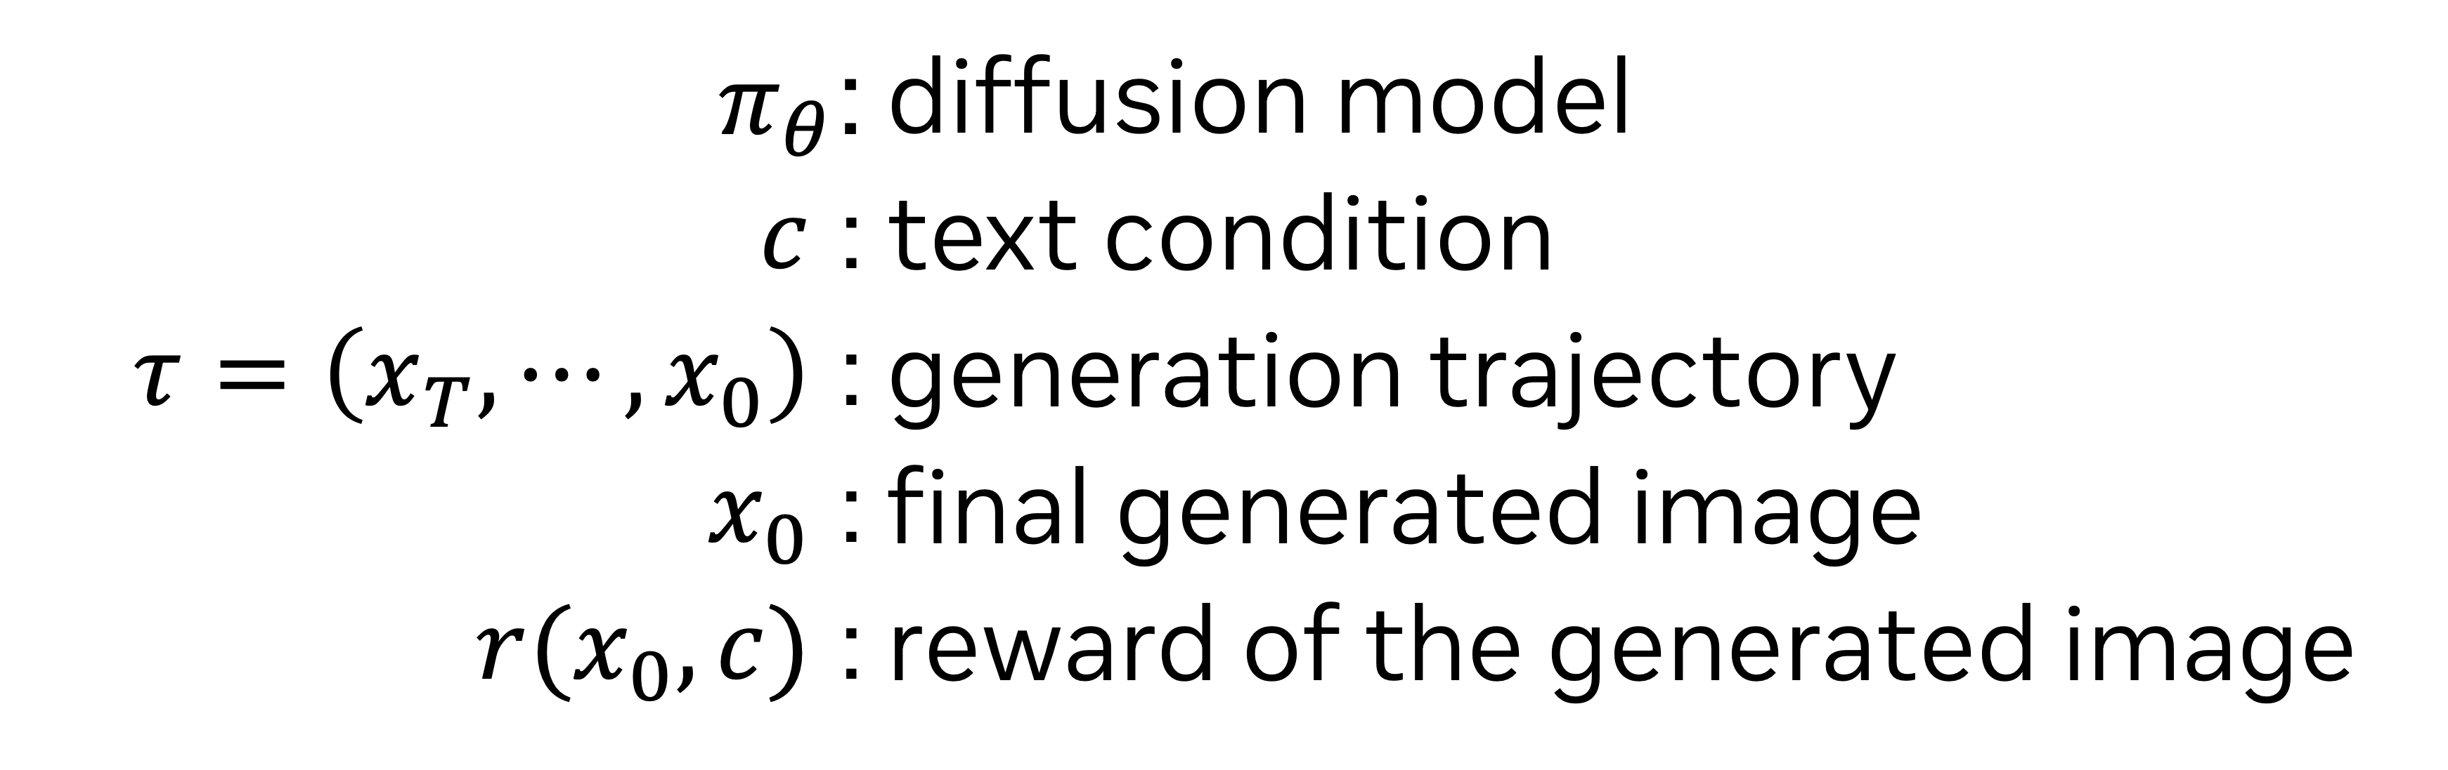
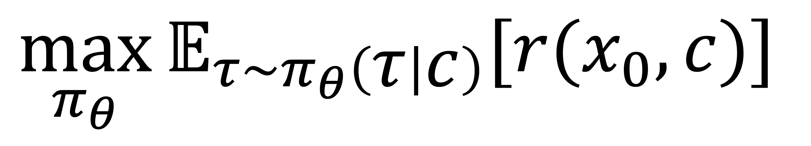
Objective of Diffusion RL: Maximizing Expected Reward
$$\max_{π_{θ}}{𝔼_{τ\sim π_{θ}\left(τ | c\right)}[r(x_{0}, c)]}$$
$π_{θ}$: | diffusion model
$c$ : | text condition
$τ=\left(x_{T},⋯,x_{0}\right)$ : | generation trajectory
$x_{0}$ : | final generated image
$r(x_{0}, c)$ : | reward of the generated image

Slide 3
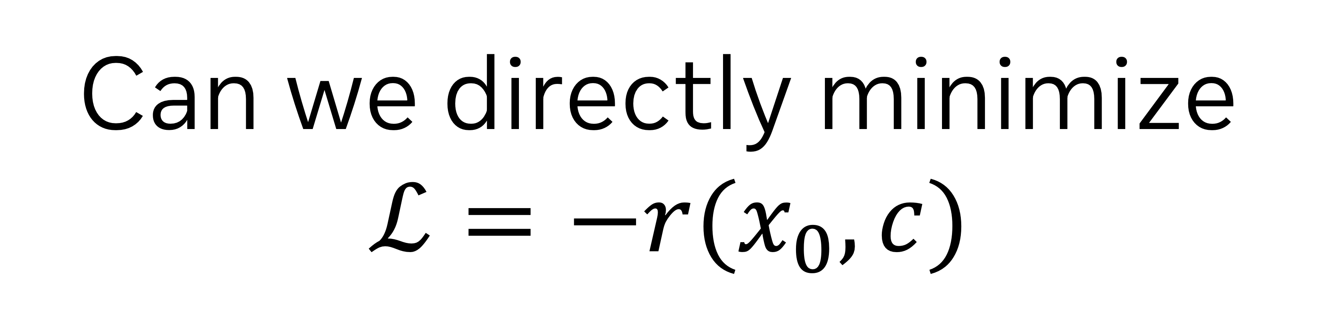
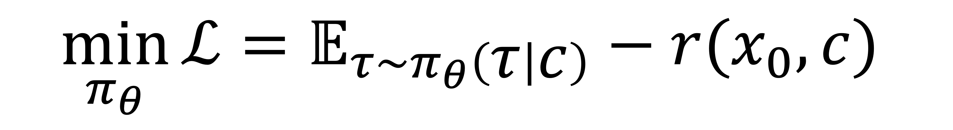
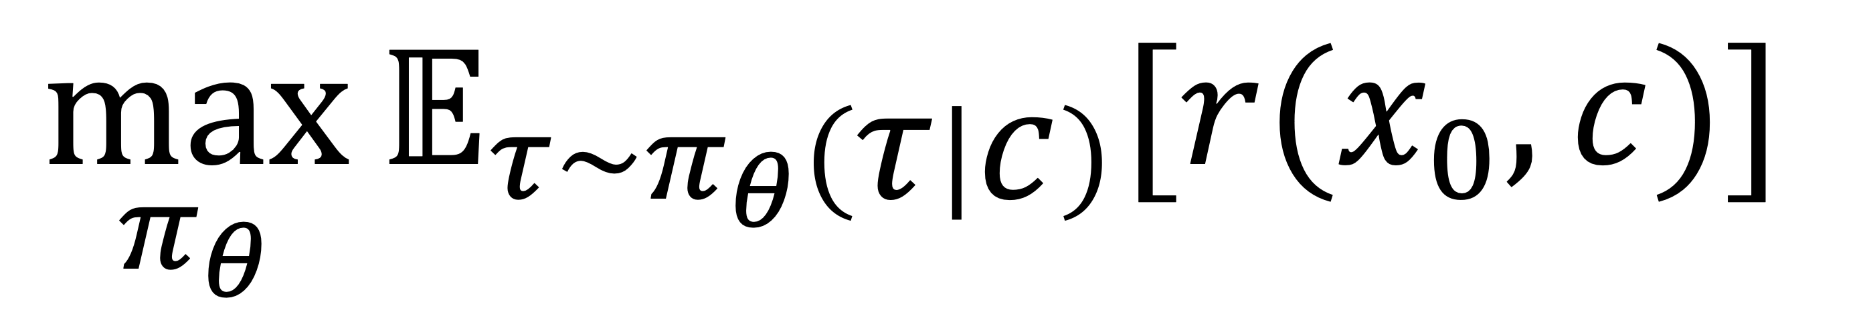
Objective of Diffusion RL: Maximizing Expected Reward
$$\max_{π_{θ}}{𝔼_{τ\sim π_{θ}\left(τ | c\right)}[r(x_{0}, c)]}$$
Can we directly minimize
$$ℒ=−r(x_{0}, c)$$
🤔
$$\min_{π_{θ}}{ℒ=𝔼_{τ\sim π_{θ}\left(τ | c\right)}−r(x_{0}, c)}$$

Slide 4
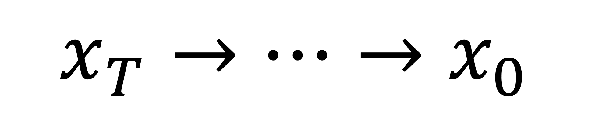

Is the Sampling Process of Diffusion Models Differentiable?
$$x_{T}→⋯→x_{0}$$
VAE Decoder
img
Reward Model
$$r$$

Slide 5
Is the Sampling Process of Diffusion Models Differentiable?
$$x_{t−1}=A_{t}x_{t}+B_{t}ε_{θ}\left(x_{t}, t, c\right)$$
Differentiable?
✅

Slide 6
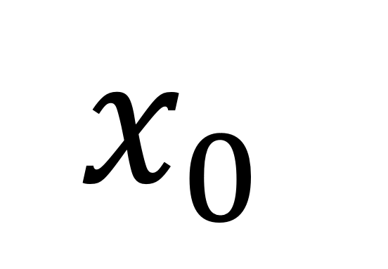
Is the Sampling Process of Diffusion Models Differentiable?
$$x_{0}$$
VAE Decoder
img
Differentiable?
✅

Slide 7

Is the Sampling Process of Diffusion Models Differentiable?
img
Reward Model
$$r$$
Differentiable?
If the reward model is differentiable
✅

Slide 8
Is the Sampling Process of Diffusion Models Differentiable?
$$x_{T}→⋯→x_{0}$$
VAE Decoder
Differentiable?
img
✅
Reward Model
$$r$$

Slide 9


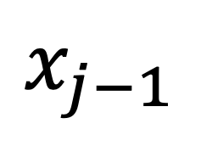
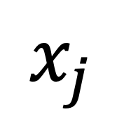
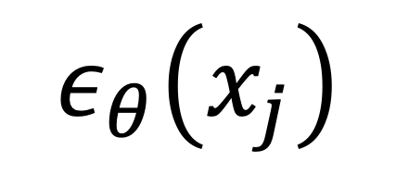
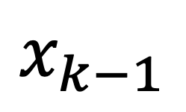

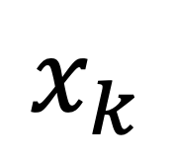
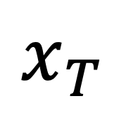
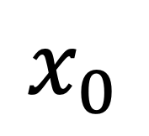
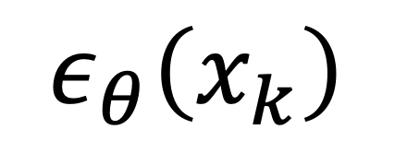
Fine-Tuning Diffusion Models by Directly Backpropagating Reward Gradients
$$ε_{θ}\left(x_{k}\right)$$
$$ε_{θ}\left(x_{j}\right)$$
···
···
$$x_{j}$$
$$x_{k−1}$$
$$x_{j−1}$$
$$x_{k}$$
···
···
···
···
$$x_{T}$$
$$x_{0}$$
Reward r
-r
Sampling Step
Input to $ϵ_{θ}$ or reward model
Backpropagation Path

Slide 10
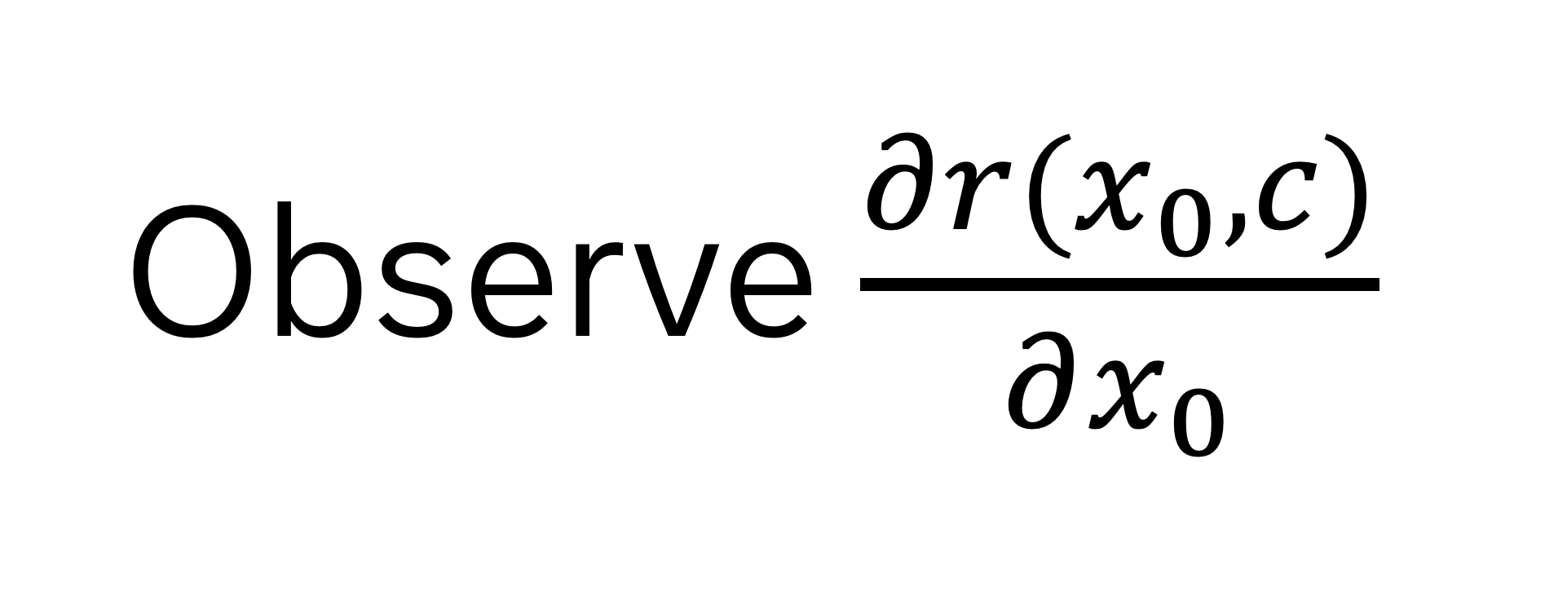
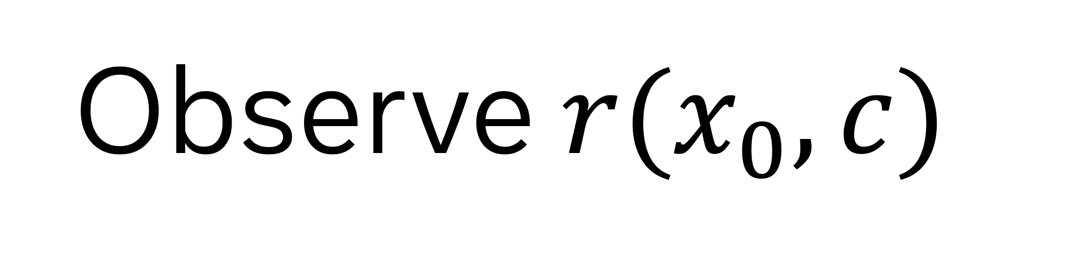
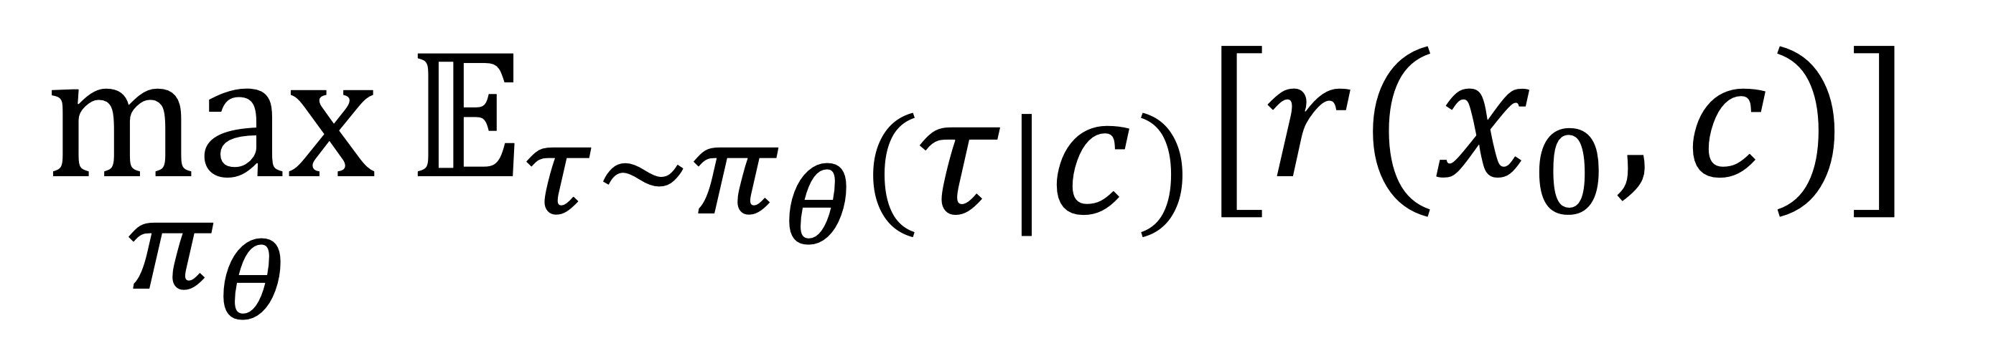
Fine-Tuning Diffusion Models by Directly Backpropagating Reward Gradients
$$\max_{π_{θ}}{𝔼_{τ\sim π_{θ}\left(τ | c\right)}[r(x_{0}, c)]}$$
direct-backpropogation methods
policy-gradient methods
Observe $r(x_{0}, c)$
Observe $\frac{∂r(x_{0}, c)}{∂x_{0}}$

Slide 11
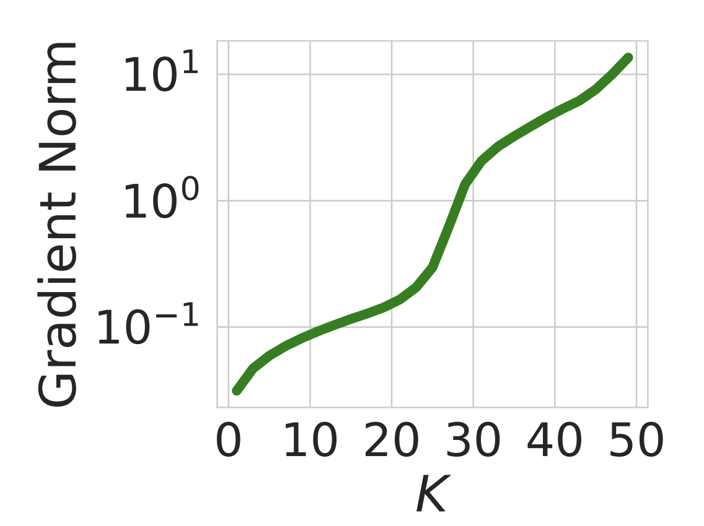

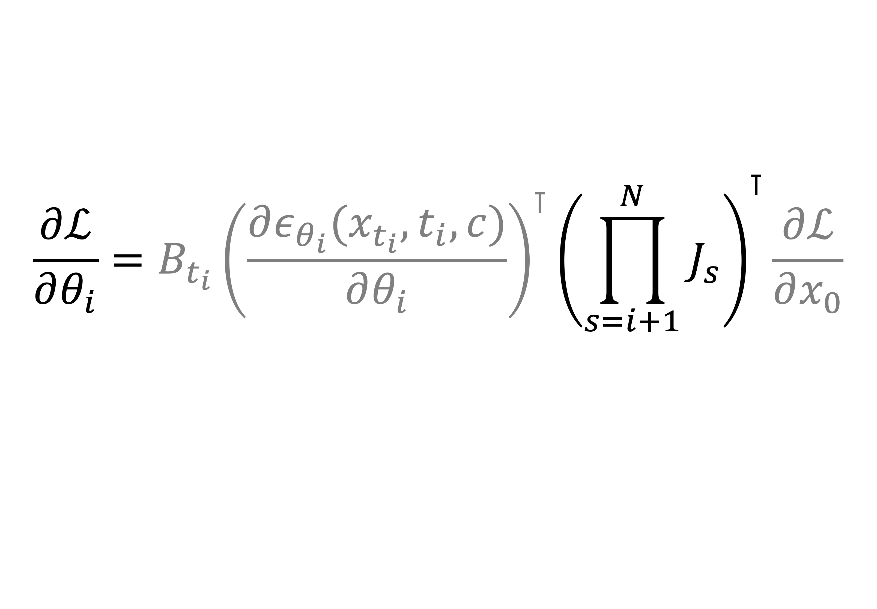

But …
1. Large Memory Cost:
Backpropagation through $N$ steps
Requires storing $N×$ activations
2. Gradient Explosion:
$$\frac{∂ℒ}{∂θ_{i}}={B_{t_{i}}{\left(\frac{∂ε_{θ_{i}}(x_{t_{i}},t_{i},c)}{∂θ_{i}}\right)}^{⊺}\left(\prod_{s=i+1}^{N}{J_{s}}\right)}^{⊺}\frac{∂ℒ}{∂x_{0}}$$
Clark, Kevin, et al. "Directly fine-tuning diffusion models on differentiable rewards." International Conference on Learning Representations. Vol. 2024. 2024.

Slide 12
How to alleviate these problems?

Slide 13
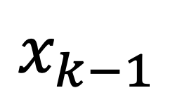
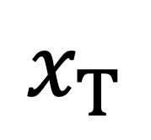
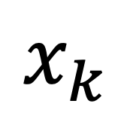

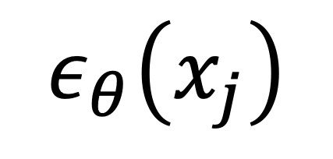
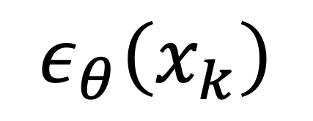
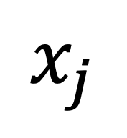
ReFL:
$$ε_{θ}\left(x_{k}\right)$$
$$ε_{θ}\left(x_{j}\right)$$
···
$$x_{j}$$
$$x_{k−1}$$
$$x_{k}$$
···
Sampling Step
$$x_{T}$$
$$x_{0}$$
Reward r
-r
Input to $ε_{θ}$ or reward model
One-Step Prediction
Backpropagation Path
Stop Gradient
Xu, Jiazheng, et al. "Imagereward: Learning and evaluating human preferences for text-to-image generation." Advances in Neural Information Processing Systems 36 (2023): 15903-15935.

Slide 14
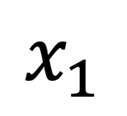
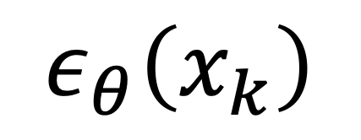
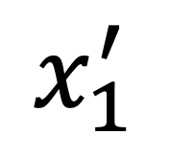
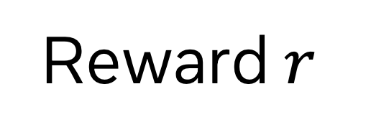
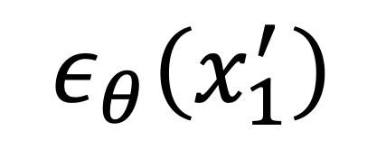
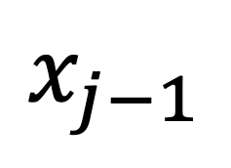
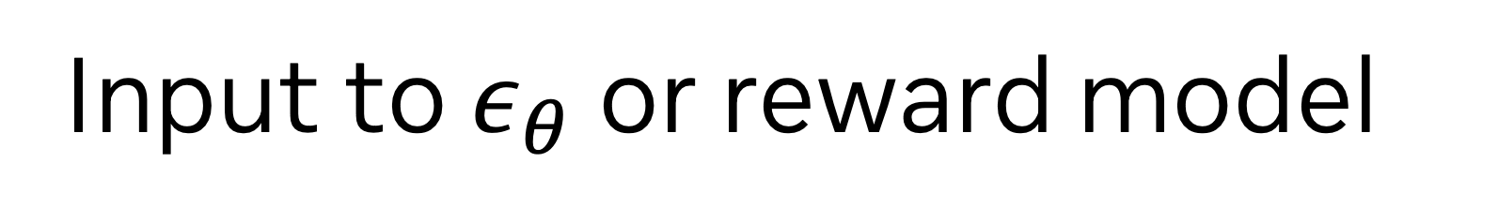
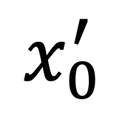
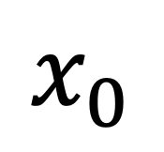
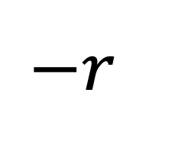
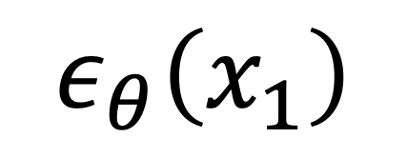
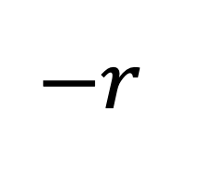
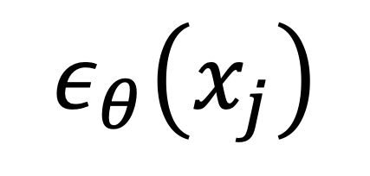
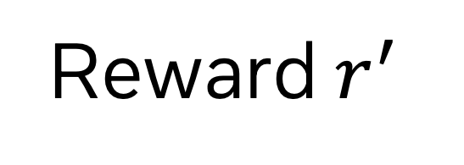
DRaFT-LV:
···
$$ε_{θ}\left(x_{k}\right)$$
$$ε_{θ}\left(x_{j}\right)$$
$$ε_{θ}\left(x_{1}^{′}\right)$$
···
$$x_{j}$$
$$x_{k−1}$$
$$x_{1}^{′}$$
$$x_{0}^{′}$$
Reward $r^{′}$
$$−r$$
$$x_{j−1}$$
$$x_{k}$$
···
$$ε_{θ}\left(x_{1}\right)$$
···
Sampling Step
$$x_{T}$$
$$x_{1}$$
$$x_{0}$$
Reward $r$
$$−r$$
Input to $ε_{θ}$ or reward model
Add Noise
Backpropagation Path
Stop Gradient
Clark, Kevin, et al. "Directly fine-tuning diffusion models on differentiable rewards." International Conference on Learning Representations. Vol. 2024. 2024.

Slide 15
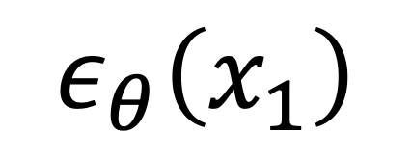
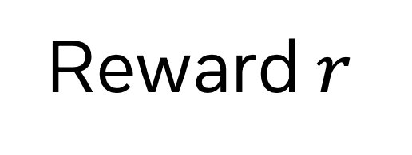
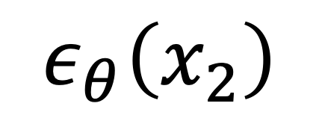
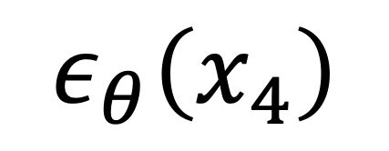
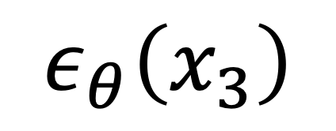
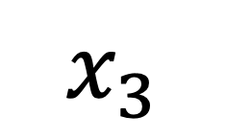
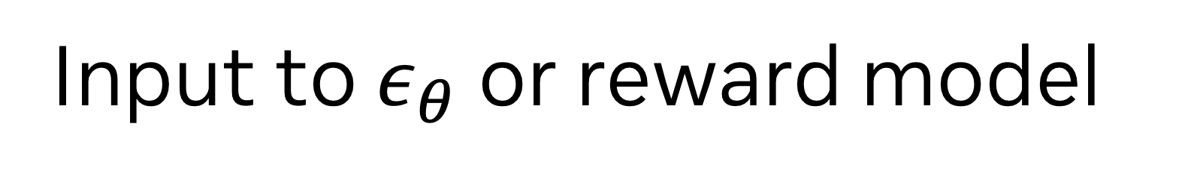
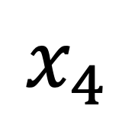
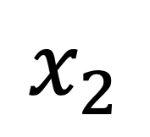
DRaFT-K:
$$ε_{θ}\left(x_{4}\right)$$
$$ε_{θ}\left(x_{3}\right)$$
···
$$x_{4}$$
$$ε_{θ}\left(x_{2}\right)$$
K=2
$$x_{k−1}$$
$$x_{3}$$
$$x_{k}$$
$$ε_{θ}\left(x_{1}\right)$$
$$x_{2}$$
···
$$x_{T}$$
$$x_{1}$$
$$x_{0}$$
Reward $r$
$$−r$$
Sampling Step
Input to $ε_{θ}$ or reward model
Backpropagation Path
Stop Gradient
Clark, Kevin, et al. "Directly fine-tuning diffusion models on differentiable rewards." International Conference on Learning Representations. Vol. 2024. 2024.

Slide 16
ReFL
Sidestep memory and gradient explosion by training only the late steps
DRaFT-LV
DRaFT-K

Slide 17
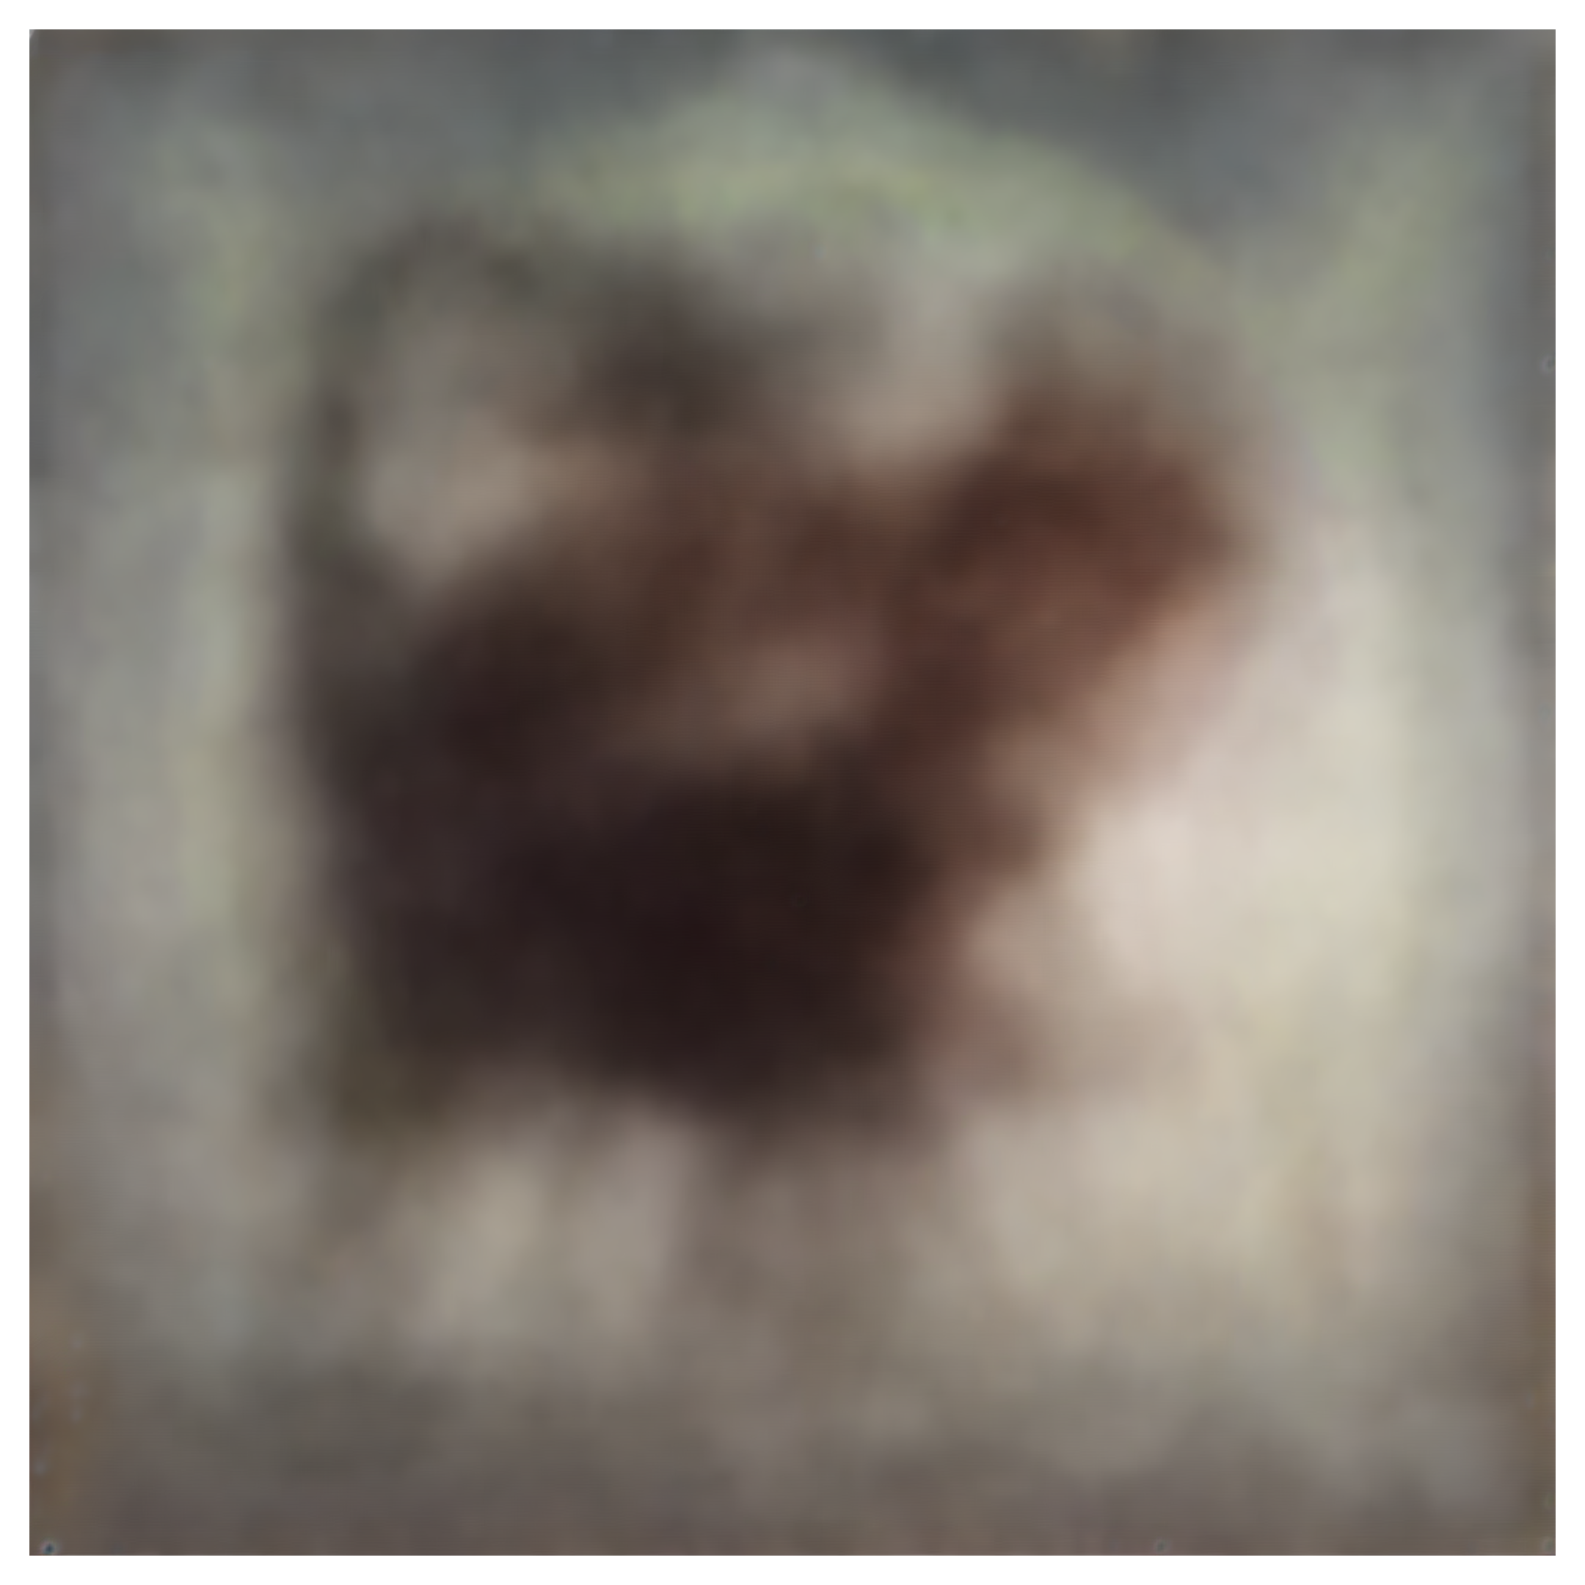








Image layout is determined in early generation steps:
Step 1
Step 10
Step 30
Step 40
Step 50
Liang, Zhanhao, et al. "Aesthetic post-training diffusion models from generic preferences with step-by-step preference optimization." Proceedings of the IEEE/CVF Conference on Computer Vision and Pattern Recognition. 2025.

Slide 18
How to Fine-Tune Early Generation Steps?

Slide 19











DRTune:
$$\frac{∂ℒ}{∂θ_{i}}={B_{t_{i}}{\left(\frac{∂ε_{θ_{i}}(x_{t_{i}},t_{i},c)}{∂θ_{i}}\right)}^{⊺}\left(\prod_{s=i+1}^{N}{J_{s}}\right)}^{⊺}\frac{∂ℒ}{∂x_{0}}$$
$$\prod_{s=i+1}^{N}{A_{t_{s}}}$$
$$ε_{θ}\left(x_{k}\right)$$
$$ε_{θ}\left(x_{j}\right)$$
···
···
$$x_{j}$$
$$x_{k−1}$$
$$x_{k}$$
···
···
Sampling Step
$$x_{T}$$
$$x_{0}$$
Reward $r$
$$−r$$
Input to $ε_{θ}$or reward model
One-Step Prediction
Backpropagation Path
Stop Gradient
Wu, Xiaoshi, et al. "Deep reward supervisions for tuning text-to-image diffusion models." European Conference on Computer Vision. Cham: Springer Nature Switzerland, 2024.

Slide 20

Direct-Align:
···
$$x_{j}$$
$$x_{k−1}$$
$$x_{j−1}$$
$$x_{k}$$
···
···
$$x_{T}$$
$$x_{0}$$
Sampling Step
Shen, Xiangwei, et al. "Directly aligning the full diffusion trajectory with fine-grained human preference." arXiv preprint arXiv:2509.06942 (2025).

Slide 21





Direct-Align:
··· ···
$$x_{k}^{′}$$
$$x_{k−n}^{′}$$
$${x_{k−n}^{′}=α_{t_{k−n}}x_{0}+σ_{t_{k−n}}ε}_{gt}$$
$${x_{k}^{′}=α_{t_{k}}x_{0}+σ_{t_{k}}ε}_{gt}$$
$$ε_{gt}$$
$$x_{0}$$
Add Noise
Shen, Xiangwei, et al. "Directly aligning the full diffusion trajectory with fine-grained human preference." arXiv preprint arXiv:2509.06942 (2025).

Slide 22






Direct-Align:
$$ε_{θ}\left(x_{k}^{′}\right)$$
$$x_{0}^{′}=\frac{x_{k}^{′}−∆σ_{t_{k}}ε_{θ}\left(x_{k}^{′}\right)−(σ_{t_{k}}−∆σ_{t_{k}})ε_{gt} }{α_{t_{k}}}$$
$$x_{k}^{′}$$
$$x_{0}^{′}$$
Reward $r$
$$−r$$
··· ···
$$ε_{gt}$$
$$x_{0}$$
$$x_{k−n}^{′}$$
Shen, Xiangwei, et al. "Directly aligning the full diffusion trajectory with fine-grained human preference." arXiv preprint arXiv:2509.06942 (2025).

Slide 23



Direct-Align:
One-Step Prediction
One-Step Prediction
of Direct-Align
($∆σ=0.075)$
One-Step Prediction
of Direct-Align
($∆σ=0.025)$
Shen, Xiangwei, et al. "Directly aligning the full diffusion trajectory with fine-grained human preference." arXiv preprint arXiv:2509.06942 (2025).

Slide 24












For DRTune and Direct-Align:
$$ε_{θ}\left(x_{k}\right)$$
$$x_{0}$$
Reward $r$
$$−r$$
$$\frac{∂ℒ}{∂θ}=\sum_{i}{C_{t_{i}}\left(\frac{∂ε_{θ_{i}}(x_{t_{i}},t_{i},c)}{∂θ_{i}}\right)\frac{∂(−r)}{∂x_{0}}}$$
$$ε_{θ_{j+1}}\left(x_{j+1}\right)$$
$$ε_{θ_{k}}\left(x_{k}\right)$$
$$x_{j+1}$$
$$x_{j}$$
$$x_{0}$$
Reward $r$
$$−r$$
$$\frac{∂ℒ}{∂θ_{k}}=C_{t_{k}}\frac{∂ε_{θ_{k}}(x_{k},t_{k},c)}{∂θ_{k}}\frac{∂ε_{θ_{j+1}}(x_{j+1},t_{j+1},c)}{∂x_{j+1}}\frac{∂(−r)}{∂x_{0}}$$
Gradient terms that capture inter-step interactions are removed !

Slide 25
How to Fine-Tune Early Generation Steps While Preserving the Gradient Terms Capturing Inter-Step Interactions?

Slide 26

AlignProp:
$$ε_{θ}\left(x_{4}\right)$$
$$ε_{θ}\left(x_{3}\right)$$
$$ε_{θ}\left(x_{k}\right)$$
···
$$ε_{θ}\left(x_{2}\right)$$
···
$$x_{4}$$
$$x_{k−1}$$
$$x_{3}$$
$$x_{k}$$
$$ε_{θ}\left(x_{1}\right)$$
···
$$x_{2}$$
···
Randomly Truncate
$$x_{T}$$
$$x_{1}$$
$$x_{0}$$
Reward $r$
$$−r$$
Sampling Step
Input to $ε_{θ}$ or reward model
Backpropagation Path
Stop Gradient
Prabhudesai, Mihir, et al. "Aligning text-to-image diffusion models with reward backpropagation." (2023).

Slide 27










ShortFT:
$$ε_{distill}\left(x_{k−1}\right)$$
$$ε_{θ}\left(x_{j}\right)$$
$$ε_{distill}\left(x_{j−1}\right)$$
$$ε_{θ}\left(x_{k}\right)$$
$$x_{k−2}$$
···
$$x_{j}$$
$$x_{k−1}$$
$$x_{j−1}$$
$$ε_{θ}\left(x_{1}\right)$$
···
$$x_{k}$$
···
···
$$x_{T}$$
$$x_{1}$$
$$x_{0}$$
Reward $r$
$$−r$$
Sampling Step
Input to $ε_{θ}$, $ε_{distill}$or reward model
Backpropagation Path
Guo, Xiefan, et al. "ShortFT: Diffusion model alignment via shortcut-based fine-tuning." 2025 IEEE/CVF International Conference on Computer Vision (ICCV). IEEE, 2025.

Slide 28


















LeapAlign
$${\hat{x}}_{0|j}=x_{j}−jv_{θ}\left(x_{j}\right)$$
$$x_{j}={\hat{x}}_{j|k}+\text{stop_grad}(x_{j}−{\hat{x}}_{j|k})$$
$${\hat{x}}_{j|k}=x_{k}−(k−j)v_{θ}\left(x_{k}\right)$$
$$x_{0}={\hat{x}}_{0|j}+\text{stop_grad}(x_{0}−{\hat{x}}_{0|j})$$
One-Step Prediction
Latent Connector
One-Step Prediction
Latent Connector
$$v_{θ}\left(x_{k}\right)$$
$${\hat{x}}_{j|k}$$
$$v_{θ}\left(x_{j}\right)$$
$$\frac{∂ℒ}{∂{\hat{x}}_{j|k}}:=\frac{∂ℒ}{∂x_{j}}$$
···
$$x_{j}$$
$$x_{k−∆t}$$
$$x_{j−∆t}$$
$${\hat{x}}_{0|j}$$
$$x_{k}$$
···
···
ODE Sampling Step
$$x_{1}$$
$$v_{θ}$$
$$x_{0}$$
Reward $r$
$$−r$$
Input to
One-Step Prediction
Latent Connector
Backpropagation Path
$x_{k}→({\hat{x}}_{j|k} ⇢x_{j})$ $→({\hat{x}}_{0|j}⇢x_{0})$
Liang, Zhanhao, et al. "LeapAlign: Post-Training Flow Matching Models at Any Generation Step by Building Two-Step Trajectories." arXiv preprint arXiv:2604.15311 (2026).

Slide 29

LeapAlign: Gradient Discounting
This nested-gradient term may have a large norm.
DRTune removes it to stabilize optimization.
Liang, Zhanhao, et al. "LeapAlign: Post-Training Flow Matching Models at Any Generation Step by Building Two-Step Trajectories." arXiv preprint arXiv:2604.15311 (2026).

Slide 30


LeapAlign: Gradient Discounting
discounting factor
$$α∈[0, 1]$$
$${\hat{x}}_{0|j}=x_{j}−jv_{θ}\left(x_{j}\right)⟹{\hat{x}}_{0|j}=x_{j}−jv_{θ}\left({αx}_{j}+(1−α)\text{stop_gradient}(x_{j})\right)$$
Liang, Zhanhao, et al. "LeapAlign: Post-Training Flow Matching Models at Any Generation Step by Building Two-Step Trajectories." arXiv preprint arXiv:2604.15311 (2026).

Slide 31














FlowBP-Lagrange
$${\hat{x}}_{j}=x_{k}−\int_{σ_{j}}^{σ_{k}}{P\left(σ\right)dσ=}x_{k}−\sum_{i∈𝒮_{pre}=\{k,k^{′}\}}{w_{i}^{L}v_{θ}\left(x_{i}\right)}$$
$${\hat{x}}_{0}=x_{j}−\sum_{i∈𝒮_{post}=\{j,j^{′}\}}{w_{i}^{L}v_{θ}\left(x_{i}\right)}$$
$$x_{j}={\hat{x}}_{j}+\text{stop_grad}(x_{j}−{\hat{x}}_{j})$$
$$x_{0}={\hat{x}}_{0}+\text{stop_grad}(x_{0}−{\hat{x}}_{0})$$
$$v_{θ}\left(x_{j}\right)$$
$${\hat{x}}_{j}$$
$$v_{θ}\left(x_{k}\right)$$
$${\hat{x}}_{k^{′}}$$
$$v_{θ}\left(x_{k^{′}}\right)$$
$${\hat{x}}_{j^{′}}$$
···
$$x_{j}$$
···
$$x_{k^{′}}$$
···
$$x_{j^{′}}$$
$$v_{θ}\left(x_{j^{′}}\right)$$
$${\hat{x}}_{0}$$
$$x_{k}$$
···
···
$$x_{1}$$
$$x_{0}$$
Reward $r$
$$−r$$
ODE Sampling Step
$$v_{θ}$$
Input to
One-Step Prediction
Backpropagation Path
Stop Gradient
Wang, Ruoyu, et al. "Exploring the Design Space of Reward Backpropagation for Flow Matching." arXiv preprint arXiv:2606.11075 (2026).

Slide 32

Directly backpropagating the reward gradient $\frac{∂r(x_{0}, c)}{∂x_{0}}$ improves training efficiency but also makes optimization more susceptible to reward hacking.

Slide 33
How to Mitigate Reward Hacking?

Slide 34


Hinge-Style Loss
$$ℒ_{reward}=\text{max}(0, λ−r(x_{0}, c))$$
reward at or above $λ$ has zero loss

Slide 35
Pretraining Loss as Regularization
$$𝒟=\{\left({txt}_{1},{img}_{1}\right),…,\left({txt}_{n},{img}_{n}\right)\}$$
$${ℒ_{pre}=𝔼_{\left(c, x_{0}\right)\sim 𝒟}𝔼_{t,ε}\left\|ε−ε_{θ}(α_{t}x_{0}+σ_{t}ε, t,c)\right\|}_{2}^{2}$$
$$ℒ=ℒ_{reward}+λℒ_{pre}$$

Slide 36


















ImageReFL
$$ε_{pre}$$
$$ε_{pre}$$
$$ε_{pre}$$
$$ε_{θ}$$
$$ε_{θ}$$
$$ε_{θ}$$
$$ε_{θ}$$
Inference:
Pre-Trained Model
Fine-Tuned Model
$$ε_{θ}\left(x_{k}\right)$$
$$ε_{θ}\left(x_{j}\right)$$
···
$$x_{j}$$
$$x_{k−1}$$
$$x_{k}$$
···
Sampling Step
$$x_{T}$$
$$x_{0}$$
Reward r
-r
Input to $ε_{θ}$ or reward model
$$x_{k}=α_{t_{k}}x_{real}+σ_{t_{k}}ε$$
One-Step Prediction
$$x_{real}$$
$$ε$$
Backpropagation Path
Stop Gradient
Add Noise
Sorokin, Dmitrii, et al. "Imagerefl: Balancing quality and diversity in human-aligned diffusion models." arXiv preprint arXiv:2505.22569 (2025).

Slide 37

Sorokin, Dmitrii, et al. "Imagerefl: Balancing quality and diversity in human-aligned diffusion models." arXiv preprint arXiv:2505.22569 (2025).

Slide 38

















SRPO
$$r={f_{img}\left(x_{0}\right)}^{⊺}f_{txt}(c)$$
$$f_{txt}$$
“[desired attributes], [text prompt]”
$$C_{pos}$$
$$f_{txt}$$
“[unwanted attributes], [text prompt]”
$$C_{neg}$$
$${x_{k}^{′}=α_{t_{k}}x_{0}+σ_{t_{k}}ε}_{gt}$$
$$x_{0}^{′′}=\frac{x_{k}^{′}+∆σ_{t_{k}}ε_{θ}\left(x_{k}^{′}\right)−(σ_{t_{k}}+∆σ_{t_{k}})ε_{gt} }{α_{t_{k}}}$$
$$ε_{θ}\left(x_{k}^{′}\right)$$
$$x_{0}^{′}=\frac{x_{k}^{′}−∆σ_{t_{k}}ε_{θ}\left(x_{k}^{′}\right)−(σ_{t_{k}}−∆σ_{t_{k}})ε_{gt} }{α_{t_{k}}}$$
$$f_{img}\left(x_{0}^{′′}\right)$$
$$x_{0}^{′′}$$
$$x_{k}^{′}$$
$$x_{0}^{′}$$
$$f_{img}\left(x_{0}^{′}\right)$$
$$R_{inverse}={f_{img}\left(x_{0}^{′′}\right)}^{⊺}[\left(1+k\right)C_{neg}−C_{pos}]$$
$$R_{denoise}={f_{img}\left(x_{0}^{′}\right)}^{⊺}[\left(1+k\right)C_{pos}−C_{neg}]$$
$$ε_{gt}$$
Shen, Xiangwei, et al. "Directly aligning the full diffusion trajectory with fine-grained human preference." arXiv preprint arXiv:2509.06942 (2025).

Slide 39
Open Problems
As reward systems become increasingly complex, incorporating components such as OCR models, object detectors, or VLM-based judges, it becomes difficult or even impossible to backpropagate gradients through the entire reward pipeline.
A reliable reward score does not guarantee a reliable gradient, which may be noisy or misaligned with the optimization objective.
Direct gradient methods are difficult to scale. For example, increasing the batch size does not necessarily improve performance.

Slide 40
Thank You for Listening!

